Slide 1
Telemetry Version 2.0 Training for Media Devices
Presenter(s): Joe, Randy, Kailaash, Ron
Principal Investigator: Joe Tarango
FSE: Jim (PE)
Architect: Randy
Developers: Randy, Kailaash, Ron, Joe, Dave S., Lukaz
Validation: Andy S., Josh, Michelle
Triage: Alberto S.
Auto Parse: Joe, Randy, Phuong, Suba, Jean, Andrea
AE Content Provided: Behnam
Special Thanks to everyone with possibility thinking making telemetry possible!
Notes:
Joe

Slide 2
Overview
Introduction to Telemetry (1.5 hours)
Gap Analysis and Motivation
Objectives
Telemetry
Customer Alignment, feedback, projected intercepts
Fundamentals
Commands
Data Format
Proprietary Format
Data Objects and magnitude
Data Areas and Objects
Notification or Query Methods
Default Telemetry Tool
Secondary Interface
Action Plan Example
Workflow
Fault Ordering, Triage, and Efficacy
Data Driven Scientific Method
Scaling NSG Big Data
External Tools Strategy
Additional Tools, Data Control, Additional Content Injection, Security, and Process, and Operational Consideration (1 hour)
Advanced Analysis Technique(s) (1 hour)
Appendix

Slide 3
Part 1 – Telemetry Overview

Slide 4
Gap Analysis and Motivation
One Liner – nLogs, SMART attributes, and BKM data alone were insufficient in many cases to debug to root cause
NSG solution for obtaining full drive debug logs required:
Customer Disruption (Drive sent back to Intel – OR-- Onsite AE Support)
Drive pulled from customer system.
Drive removed from system harness.
Drive installed into AE-in-a-box 2.0 System .
Vendor Unique (VU) commands used to pull Triage Logs.
Extract all the relevant logs (PLI dumps, side trace, etc.); prone to human error.
Multiple drives may fault at once so method can be repeated several times.
Developer
Content available without Special Tools
TWIDL cannot be used in the field.
Unlocking drive requires significant overhead.
Removing content can change drive state.
Healthy drives have no data saved at time of failure.

Slide 5
Objectives
TTD is defined by determinate timeline from the fault appearance to the confirmation of adequate evidence to proceed a technical resolution strategy. Thus, TTD is the optimizable variable within the telemetry initiative.
Understand the mechanisms within telemetry so engineers can:
Save all data using available tools.
Verify content.
Provided concise list of telemetry data included.
Characterization of the system setup, usage, and the sequence to the fault event.
Diligently develop a problem statement using the scientific method by reducing scope.
When a fault case is not clear provide feedback for how we can improve the methodology in future engagements.
Improve the NSG fault analysis handbook with encountered evaluations.

Slide 6

Telemetry
Intel’s remote method for a device to capture and save pertinent data
Uses standard command interface for all products
Adheres to Industry Standardization
NVMe 1.3 Telemetry Specification
SATA ACS 4 Definitions
Decoupling
Minimize the returned Intel devices in the field
Complex propriety tools such as AE-in-a-box no longer required
Availability of Customer own tool chain interface to retrieve logs in customer environment (Linux, MS Windows, …)
Generally, accelerate fault analysis of anomaly event detections
Internally (ConVal and PV)
Externally filed (Customer)

Slide 7
Customer Alignment
Telemetry is viewed by our customers to be the critical fault analysis method
NSG working group has a public blog to accumulate feedback
Customer Requests
Interpret a portion of the data payload for analysis
The initial evaluation should be able to summarize the meta data contained
Provide a scope of failure
Deliver key incites for customer actions while NSG creates a technical resolution plan
In the Field Usage
One-time event data save
Drive notifies a anomaly through Controller Initiated Telemetry Admin Command (CiTAC) Asynchronous Event
When there are multiple events occurring; each will notify until all the data is retrieved
Drive fails and host pulls a dynamic log through Host initiated Telemetry admin Command (HiTAC) Query
Periodic Healthy Drive Telemetry Data Pulls
Healthy logs archived by customer and can be contrasted against the failure when it arrives
Periodic Healthy Drive Telemetry Data Pulls – During qualification, logs pulled and archived by customer during failing performance tests. These logs can be used to debug the performance issue.

Slide 8
Telemetry Customer Requirements and Feedback
Facebook
Less than 1% for stability IOPs performance
Less than 10 ms in QoS
WAF impact disclosed
Limit of 100KB on Data Area1 (was removed later on)
Huawei (July 2018) thinks Telemetry is promising and asked for parsing capability to understand meaning of telemetry logs. Huawei also requested SATA working behind RAID card for best compatibility and utility.
Huawei would like telemetry log data to include predictive failure indicator so Huawei can minimize failure impact to their data center/customer
Alibaba (July 2018) was super excited about telemetry, especially version two with support to retrieve telemetry log even when drive context is compromised. Ali also requested customer parser to interpret telemetry log for the purpose of understanding potential drive health issues and for proactive action in case of potential drive failure. Ali requested a firmware with telemetry capability for their internal testing. Additionally, Ali requested training on Intel telemetry implementation and recommendation of which stats to monitor as indications of potential drive health/failure.
Baidu (July 2018) would like to integrate telemetry log parsing into their environment to monitor drive performance and take proactive action in case of potential or actual failure (including drive Assert, what they mean, and how to confirm is serious or just informative)
Especially interested to understand key parameters available via telemetry log that may indicate potential drive problem or drive failure;
Baidu wants to monitor these parameters and set threshold to take action, so they have more control of drive impact to their business and customers.
Oracle has also asked for some similar functionally where they triage the drive themselves and provide feedbacks to their end customers.
Notes:
“Customer Requirements and Feedback”: We need to get the AE’s to push back on the customer parsing for failure prediction. That is what SMART is supposed to do. If we need enhancements then we need to add them there. Telemetry is designed to help us figure out what went wrong after the error. As such it’s predictive capacity is no better than SMART.

Slide 9
Telemetry Fundamentals

Slide 10
Fundamentals
Intel has decided to use the NVMe 1.3 Telemetry specification as a basis for all products (including SATA products based on ACS 4 definitions).
The NVMe 1.3 specification defines two new log pages:
Host Initiated Telemetry Log (log page identifier 0x07)
Controller Initiated Telemetry Log (log page identifier 0x08).
The SATA ACS-4 specification defines two new log pages:
Current Device Internal Status Data Log (log address 0x24)
Saved Device Internal Status Data Log (log address 0x25).
The both Telemetry specification defines that the page return data contains:
Standard header specified
Data requested must be multiple of 512 Bytes
Up to three consecutive data areas
We defined what internal data needs to be packaged into the telemetry data sets.
The data list, values, and details are dynamic so the content can be customized per usage.
Telemetry is a method to request and extract data. It includes 2 steps:
Pulling / extracting / collecting the information
Parsing the information - a disjoint technique related to the auto parser
(Telemetry does not do any analysis. Also, no need to unlock the drive since we issue standard commands)

Slide 11
Telemetry Key Commands
NVMe
Identify controller data structure (ICDS; support of host and controller telemetry)
Asynchronous event Configuration (AEC; host enablement of the (H/C)iTaC event notifications) feature identifier 0Bh
Asynchronous event information notice (AEIN; detection field if telemetry log changed)
Log page identifiers (LPI; 07h host, 08h controller)
Create Host-Initiated Data (CHID; create a non-volatile snapshot of the telemetry data)
Get log page (GLP; access information to the log page payloads)
SATA
Identify controller data structure (ICDS; support of host and controller telemetry)
Log Address(LA; 24h host initiated, 25h device initiated)
Create Host-Initiated Data (CHID; create a non-volatile snapshot of the telemetry data)
Read Log Ext (PIO) / Read Log DMA Ext (LA; access information to the log page payloads)

Slide 12
Telemetry Get Log Page 0x7 - NVMe
Initial Version 1 support limited to
Host-Initiated Telemetry log
Telemetry Data Area 1
4KB-align data payload
4KB data payload transfer size
Requested transfer size must be the same for one “instance” of Get Log Page commands
4 parameters in Get Log Page 0x7 are required
Log Page Identifier
Number of DWORDS
Log Specific Field
Log Page Offset
Version 2 (includes V1 capabilities)
Support Enhancements
512B - 128KB transfer size
Controller-Initiated Telemetry log
Create Bit Persistence
Requirements
Data requested must be multiple of 512 bytes per NVMe 1.3 Specification
Requested Offset must be multiple of 512 bytes per NVMe 1.3 Specification
Get Log Page | LID 0x7 | LSF = 1 | NUMD = 1023 | LPO = 0

Slide 13
Telemetry Read Log Page 0x24 - SATA
Initial Version 1 support limited to
Host-Initiated Telemetry log
Telemetry Data Area 1
4KB-align data payload
4KB data payload transfer size
Requested transfer size must be the same for one “instance” of Read Log Page commands
3 parameters in Read Log Address 0x24 are required
LBA (Log Address)
Log Page Count
Feature
Version 2 (includes V1 capabilities)
Support Enhancements
512B - 64KB transfer size
Controller-Initiated Telemetry log
Create Bit/ Feature bit Persistence
Requirements
Data requested must be multiple of 512 bytes per ACS-4 Specification
Requested Offset must be multiple of 512 bytes per ACS-4 Specification
Note: Page Number field is part of LBA (See ACS-4 spec – Table 75, 76 & section 7.22, 7.23)
Read Log Ext | LBA=0x24 | LPC=1 | Feature=1

Slide 14
Telemetry Log Block Access
Byte | Description
0 | Log Identifier NVMe Log Identifier (07h for Host-Initiated log, 08h for Controller-Initiated log) SATA Log Address (24h for Current Device Status Log, 25h for Saved Device Log)
4:1 | Reserved
7:5 | IEEE OUI Identifier (unique to Intel)
9:8 | Telemetry Host-Initiated Data Area 1 Last Block
11:10 | Telemetry Host-Initiated Data Area 2 Last Block
13:12 | Telemetry Host-Initiated Data Area 3 Last Block
381:14 | Reserved
382 | Controller Initiated Log available 0 = no log, 1 = present
383 | Controller initiated Log Generation Number (value = 0 to 255)
IEEE OUI is the Intel unique OEM identifier
Telemetry Host-Initiated Data Area 1 relates to the last block with data populated
Specification indicates:
Data areas 2 must be greater than or equal to data area 1
Data area 3 must be greater than or equal to data area 2

Slide 15
Telemetry Access Details - NVMe
Host requires bytes 9:8 in Telemetry Host-Initiated Data Area 1
Last Block to determine how many subsequent Get Log Page 0x7 commands to send
Number of commands to send (N) = (Last Block) / (Transfer size)
Get Log Page (1) | LID 0x7 | LSF = 1 | NUMD = (Transfer size /4) | LPO = 0
Get Log Page (1) | LID 0x7 | LSF = 0 | NUMD = ((Transfer size/4) – 1) | LPO = Transfer Size * 1
Get Log Page (2) | LID 0x7 | LSF = 0 | NUMD = ((Transfer size/4) – 1) | LPO = Transfer size * 2
Get Log Page (3) | LID 0x7 | LSF = 0 | NUMD = ((Transfer size/4) – 1) | LPO = Transfer size * 3
…
Get Log Page (N) | LID 0x7 | LSF = 0 | NUMD = ((Transfer size/4) – 1) | LPO = Transfer size * N

Slide 16
Telemetry Access Details - SATA
Host requires bytes 9:8 in Telemetry Host-Initiated Data Area 1
Last Block to determine how many subsequent Read Log Page = 0x24 commands to send
Number of commands to send (N) = (Last Block) / (Transfer size)
Read Log Ext (1) | LBA 0x24 | Feature=1 | BlockCount=1 (512 bytes)
Read Log Ext (0x1) | LBA 0x124 | Feature=0 | BlockCount=1 (512 bytes)
Read Log Ext (0x2) | LBA 0x224 | Feature=0 | BlockCount=1 (512 bytes)
Read Log Ext (0x3) | LBA 0x324 | Feature=0 | BlockCount=1 (512 bytes)
…
Read Log Ext (0xFF) | LBA 0xFF24 | Feature=0 | BlockCount=1 (512 bytes)
Read Log Ext (0x1FF) | LBA 0x100FF24 | Feature=0 | BlockCount=1 (512 bytes)
Read Log Ext (0x2FF) | LBA 0x100FF24 | Feature=0 | BlockCount=1 (512 bytes)
…
Read Log Ext (0xFFFF) | LBA 0xFF00FF24 | Feature=0 | BlockCount=1 (512 bytes)

Slide 17
Host and Controller Initiated get Log Page Identifier - NVMe
Bit | Description
00 | Log Identifier: This field shall be set to 07h (Host) and 08h (Controller)
04:01 | Reserved
07:05 | IEEE OUI Identifier (IEEE): Contains the Organization Unique Identifier (OUI) for the controller vendor that is able to interpret the data. If set to 0h, no IEEE OUI Identifier is present. The OUI shall be a valid IEEE/RAC assigned identifier that is registered at http://standards.ieee.org/develop/regauth/oui/public.html.
09:08 | Telemetry Initiated Data Area 1 Last Block: Contains the value of the last block of Telemetry Initiated Data Area 1. If the Telemetry Initiated Data Area 1 does not contain data, then this field shall be cleared to 0h. If this field is not 0h then Telemetry Initiated Data Area 1 begins at block 1h and ends at the block indicated in this field.
11:10 | Telemetry Initiated Data Area 2 Last Block: Contains the value of the last block of Telemetry Initiated Data Area 2. This value shall be greater than or equal to the value in the Telemetry Initiated Data Area 1 Last Block field. If this field is not 0h then Telemetry Initiated Data Area 2 begins at block 1h and ends at the block indicated in this field.
13:12 | Telemetry Initiated Data Area 3 Last Block: Contains the value of the last block of Telemetry Initiated Data Area 3. This value shall be greater than or equal to the value in the Telemetry Initiated Data Area 2 Last Block field. If this field is not 0h then Telemetry Initiated Data Area 3 begins at block 1h and ends at the block contained in this field.
Bit | Description
381:14 | Reserved
382 | Telemetry Controller Initiated Data Available: Contains the value of Telemetry Controller-Initiated Data Available field in the Telemetry Controller-Initiated Log
383 | Telemetry Controller-Initiated Data Generation Number: Contains the value of the Telemetry Controller-Initiated Data Generation Number field in the Telemetry Controller-Initiated Log
511:384 | Reason Identifier: Contains a vendor specific identifier that describes the operating conditions of the controller at the time of capture. The Reason Identifier field should provide an identification of unique operating conditions of the controller.
1023:512 | Telemetry Initiated Data Block 1: Contains Telemetry Data Block 1 for the Telemetry Initiated Log
1535:1024 | Telemetry Initiated Data Block 2: Contains Telemetry Data Block 2 for the Telemetry Initiated Log.
… | …
(n*512)+511 :(n*512) | Telemetry Initiated Data Block n: Contains Telemetry Data Block n for the Telemetry Initiated Log.

Slide 18
Host and Controller Initiated get Log Page Identifier - SATA
Bit | Description
00 | Log Identifier: This field shall be set to 24h (Host) and 25h (Device)
04:01 | Reserved
07:05 | IEEE OUI Identifier (IEEE):The IEEE OUI field shall contain a 24-bit canonical form OUI assigned by the IEEE to the organization that is able to interpret the Current Device Internal Status Data in this log.
09:08 | Device Internal Status Data Area 1 Last Log Page: Contains the value of the last log page of Device Internal Status Data Area 1. If the Device Internal Status Data Area 1 does not contain data, then this field shall be cleared to 0h. If this field is not 0h then Device Internal Status Data Area 1 begins at page 1h and ends at the page indicated in this field.
11:10 | Device Internal Status Data Area 2 Last Log Page: Contains the value of the last log page of Device Internal Status Data Area 2. This value shall be greater than or equal to the value in the Device Internal Status Data Area 1 Last page field. If this field is not 0h then Device Internal Status Data Area 2 begins at page 1h and ends at the page indicated in this field.
13:12 | Device Internal Status Data Area 3 Last Log Page: Contains the value of the last log page of Device Internal Status Data Area 3. This value shall be greater than or equal to the value in the Device Internal Status Data Area 2 Last page field. If this field is not 0h then Device Internal Status Data Area 3 begins at page 1h and ends at the page contained in this field.
Bit | Description
381:14 | Reserved
382 | Saved Data Available: Contains the value of Saved Device Internal Status Data Available field in the Saved Device Internal Status Data Log
383 | Saved Data Generation Number: Contains the value of the Saved Device Internal Status Data Generation Number field in the Saved Device Internal Status Data Log
511:384 | Reason Identifier: Contains a vendor specific identifier that describes the operating conditions of the controller at the time of capture. The Reason Identifier field should provide an identification of unique operating conditions of the controller.
1023:512 | Telemetry Initiated Data Block 1: Contains Telemetry Data Block 1 for the Telemetry Initiated Log
1535:1024 | Telemetry Initiated Data Block 2: Contains Telemetry Data Block 2 for the Telemetry Initiated Log.
… | …
(n*512)+511 :(n*512) | Telemetry Initiated Data Block n: Contains Telemetry Data Block n for the Telemetry Initiated Log.

Slide 19
NVMe and SATA Specification Divergence Summary
NVMe
Telemetry is a non-blocking administration commands so other data command can occur.
No other administration commands cannot be sent until the request is processed
Asynchronous event Request (AER) notification means the device can inform the host.
The snapshot must be kept in a state value of 0x1. HI log per spec is regenerated anytime Create = 1 or there is a reset. The retain AER only applies to the CI log.
SATA ACS-4
Telemetry is a blocking administration command so no other data can occur.
No other command on the device can be sent until the command is processed.
There is no AER (Asynchronous event Request) notification mechanism to inform the host if the drive has a Controller/ Device Initiated Telemetry (i.e. Event dump). Thus, the host has to request HIT or CIT header to see if data is available since the flags indicate the same content.
The CIT log is cleared once the last block is read.

Slide 20
Format

Slide 21
Intel Reason Identifier Structure (bytes 384 – 511 of Block 0)
Propriety definitions
Major/Minor: Reason code versioning I.E. 1.0
RC: Reason code which consists of 4 flags and a 16 bit enumerated error code value.
Firmware Revision: Details will depend on generation . I.E. single image firmware devices such as ADP have both rolled up in one image.
Serial: standard tracking of devices
Dual Port Reserved: external controller support such as CDR-DP. ADP will be an in-house variant.
Error Code: Firmware enumeration mode
Controller Initiated Log: Toggle field for extraction method.
Excursion Detected: Indication of event dump.
Warning Detected: Relates to non-critical fault
Error Detected: Error in the last assert dump detected
Byte | Description
1:0 | Reason Identifier Major Revision Number: Major revision number of the reason identifier structure. Used by internal Intel tools to determine how to decode the reason identifier structure.
3:2 | Reason Identifier Minor Revision Number: Minor revision number of the reason identifier structure. Used by internal Intel tools to determine how to decode the reason identifier structure.
7:4 | Reason Code (RC): This field contains a reason code for the log data. Refer to Table 8 for a definition of this value.
27:8 | Failure Mode String (FMS): Failure mode string. “*Healthy”, “*ASSERT_xxxxxxxx” or “*BAD_CONTEXT_xxxx”
39:28 | Intel Firmware Revision: This field contains the Intel firmware identification string. The string is stored as 6 big-endian 16-bit words as per the standard Intel FW revision big-endian data format.
51:40 | Intel Bootloader Firmware Revision: This field contains the Intel bootloader firmware identification string. The string is stored as 6 big-endian 16-bit words as per the standard Intel FW revision big-endian data format.
71:52 | Serial Number: Drive serial number string.
81:72 | TBD: Reserved for future definition.
127:88 | Dual Port Reserved: Use by dual port products only.
Bits | Definition
15:0 | Error Code: Enumerated reason error code. 0 = no error, !0 = error detected. See telemetryReasonCode_e documentation for details on the error values.
16 | Controller Initiated Log: 1 = Log was pulled using a controller initiated get log page command, 0 = Log was pulled using a host initiated get log page command.
17 | Excursion Detected: 1 = excursion level event was detected, 0 = no excursion level event detected since last controller initiated telemetry get log page command.
18 | Warning Detected: 1 = warning level event was detected, 0 = no warning level event detected since last controller initiated telemetry get log page command.
19 | Error Detected: 1 = error level event was detected, 0 = no error level event detected since last controller initiated telemetry get log page command.
31:20 | Reserved: Reserved for future use.

Slide 22
Data Set Table of Contents (Part 1)
* Each data area contains its own TOC so the next three slides pertain to the first block block of each data area
Byte | Description
0 | Major Version: Major version number (0x02).
1 | Minor Version: Minor version number (0x00).
3:2 | Entry Count: Number of valid entries in the Data Area table of contents array.
7:4 | Data Area Size: Size in bytes of the data area.
15:8 | Reserved: Reserved for future use.
(COUNT * 8) + 16 : 16 | Data Area Table of Contents (TOC) Array: Array of TELEMETRY_TABLE_OF_CONTENTS_ITEM structure entries.
Major and Minor are the data area version details
Entry count is the total entries for the area
Data area size is the active usage
Data Area Table of Contents is the total object within the data area related to our unique identifiers.
* The total size is not limited to 512 bytes.

Slide 23
Data Set Table of Contents (Part 2)
TELEMETRY_TABLE_OF_CONTENTS_ITEM Entry structure
Defines the telemetry objects
Byte | Description
3:0 | Starting Offset: Starting byte offset from the base of the data area of the telemetry data object.
7:4 | Size: Size in bytes of the telemetry data object.
Starting offset of the telemetry data object relative to the base offset of the data area.
Size is the total size of the item including the data set object header structure
The object size includes the tracking meta and the actual firmware data payload which may have the version information duplicated depending if is was tracked prior to telemetry.
The telemetry header may duplicate the data structure header version.

Slide 24
Data Set Table of Contents (Part 3)
Data Set Object Header Structure Definition
Byte | Description
1:0 | Major Version: This 16-bit value contains the major version number of the object.
3:2 | Minor Version: This 16-bit value contains the minor version number of the object.
7:4 | Object Identifier (OI): This 32-bit value identifies the data object that follows. Each object is given a unique identifier value that is used by the internal Intel tools along with the Object Revision Number (ORN) to determine the structure of the data that follows and how to parse that data. The identification list and the revision numbered data structure that follows is defined in <document name>.
8 | CPUID: CPU core identification number associated with the data. For single core products this will always be 0.
11:9 | Reserved: Reserved for future expansion
OSZ+12:12 | Data Object: Contains the telemetry data collected for the data object specified by the Object Identifier (OI), Object Revision Number (ORN) and build information values. The exact contents vary and are defined by the firmware.
Major is the telemetry major version; if it does not exist default is 1.
Minor is the telemetry minor version; if it does not exist default is 0.
Object Identifier (OI) is the data control unique identifier for the data object.
CPUID depends on the architecture in gen 3 is it the media bank and gen 4 the symmetric processor identifier.
Data Object is the source module defined content.

Slide 25
Data Objects

Slide 26
Content, Data Objects, and Magnitude
Working Group
FW Arch, FW Dev (LFE), Customer Development Engineering (CDE), 3DXP, Tools, Application Engineering, and STG
Data Area 1
Fast data analytics
Data Area 2
Extended data analytics
Data Area 3
Logs
Event Dump
Assert Dump
Data Area | Objects
All | 288
1 | 52
2 | 41
3 | 200
The architecture is designed to be dynamic thus the objects are subject to change over time.
These object list and magnitude support the product so each telemetry set can be tailored.

Slide 27
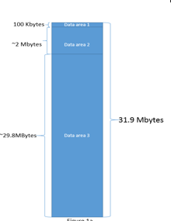
Object Information
The Telemetry log can consist of 3 data areas:
Data Area 1:
Small in size, designed for periodic pulls during operation, contains critical drive data
Data Area 2:
medium, scale up included content
Data Area 3:
large, designed to be comprehensive
None of the data areas have a fixed size. There is a target limit on data area 1 for Host Initiated of 100KBytes and there is a hard limit of 31.9MBs for the command, but the actual data area sizes are dynamic.
Data Area 1 (small - Designed to 100KB or less)
Data Set TOC (table of contents)
Drive Configs Partial
Drive Stats Partial
Transport Partial
Core Partial
Media Partial
Analytics Partial
Last 16KB of "most important" nLog data
Boundary
Data Area 2 (medium, Up to ~2MB)
Data Set TOC
Drive Configs Full
Drive Stats Full
Transport Full
Media Stats Full
Debug Full
Boundary
Data Area 3 (large, Up to ~29.8MB)
Data Set TOC
Assert/Event Dump
nLog data (FULL) - max size 8MB
Boundary

Slide 28
Notification or Query Methods

Slide 29
Controller Initiated Telemetry (CiTAC)
Controller initiates a Get Log Page (NVMe 0x08, SATA 0x25) on internal minor or major issue is detected (such as: event dump or Assert dump) . Most other dynamic data is not current after a dump.
Always provides a single data area (up to 31.9MB)
Drive States:
Non-Asserted Drive (including case of event dump)
Non-Asserted drive will have one data area with all (product selected) data objects.
Examples include but are not restricted to internal command time out, unrecovered data read, mis-compare or thermal threshold error
On an internal error, the drive indicates to Host it has a CIT Log available via the Asynchronous Event Request (AER) mechanism described in NVMe 1.3.
Asserted Drive
When the drive is in the Asserted state telemetry commands are still available. The host should pull the assert telemetry log using either the Controller-Initiated Log page (0x08, 0x25) or the Host-initiated log page (0x07, 0x024)”
Notes:
Bad Context Drive
Since we do know where the meta data are being located and how to recognize them, we can do physical scan of the media. This is only possible if the drive is not AES encrypted
llf() will recover the drive but host data will be gone.
You can do a scan for the parsePliDump on NAND drives to see if there are problem with PLI save and restore
You can examine the content of PliSlice on 3DXP drive to see if there is a problem with PLI save and restore.
Also based on the BAD_CTX number, FW guy can help deduce why the drive has gone into badctx
on NAND drive, you can do physical media scan to locate remnants fast context to extract the L2P table for closer examination
But this will take a lot of effort and results may vary.
The only way CIT would work is if you knew that you were about to get into a bad context situation.
Unfortunately in most cases, we don't have that much advanced warning. So our normal NAND storage is cannot help us.
Right now the plan is to use Sidetrace to provide enough information to discern what path we took to get into a bad context state.
Not much to be done for CIT.

Slide 30
Host Initiated Telemetry (HiTAC)
Host initiates a Telemetry data log file containing Data Areas (DA) 1-3 supported
Controller initiated is driven by either an event or Assert; which will be in the HIT if pulled.
Non-Asserted Drive
DA1 – Not to exceed 100KB for periodic data pulls
Intended for functional drive data performance / long term health monitoring
Customer sends DA1 snapshot log to drive vendor for assessment
DA1, DA2 & DA3: Full Log pull (Max Size = 31.9MB)
Used when Host detects an error the drive has not, such as QoS issue /Command Timeout
Asserted Drive
DA1, DA2 & DA3 – All data necessary to facilitate remote root cause debug resolution by Intel
The data payload may contain multiple or single data areas.
The data area will contain the assert dump data.

Slide 31
Default Telemetry Tool

Slide 32
Internal Triage
Allows for capturing and parsing of portions of the Telemetry binary log
Should be used by AEs, Devs, TSSs; only internal;
>Triage.exe –t <Telemetry.bin> --testball <path>
The tool currently parses the following data objects:
nLog (Both NAND and Optane)
Assert Dump (Assert Dump header and nLog)
Event Dumps (Event Dump header and nLog)
Sidetrace - may not be included depending on the fault
APL nLog
APL Crash dump (On Linux systems only), Intel does not have access to the decoder
Ongoing, iterative enhancements for V2 Telemetry version will add additional parsing & analysis over time. It’s WIP.
Always save the original entire binary! In the case, developers want to parse with disjoint scripts!

Slide 33
Action Plan Example

Slide 34
Customer Engagement Action Plan
The main intent of Telemetry is to quickly root cause the customer issues, so we need you to:
Quickly triage the issue
Attach the Telemetry binary log(s) to an NCT
Ensure that the TME and the F/W team quickly knows about it for root cause.
Currently add:
Program Manager to “Mail List” of the
NAND NCT
3DXP NCT
Later on, the data should go to the TMEs which will assign appropriate Triage
Add information to the NCT that will allow us to track NCTs with telemetry logs attached (V1 vs V2)
Utilize existing metrics to demonstrate improvement for NCT response time.
We have a chance here significantly reduce the time to root cause and delight our customers!

Slide 35
Workflow

Slide 36
Telemetry and JIRA
Ideal Jira Flow for NCT Sightings with Telemetry data
Customer pulls Telemetry Log (ConMan, QST or NVMe-CLI) and provides an SDR to TSS/AE
AE creates NCT, attaches Log and Completed SDR and moves to Triage stage
AE executes Triage w/Telemetry File as input & writes up Triage Summary
AE checks for similar failure signatures and annotates either way
AE moves JIRA to Eng Backlog
Program Manager/Technical Leads Prioritize and Assign
Engineer Evaluation for Root Cause
Domain Team Collaboration for appropriate solution paths
Developed Patch pushed to appropriate node
Program Manager/Team Leads Synchronize Landing Zone
Closed Loop feedback for other products and architecture

Slide 37
Fault Ordering, Triage, and Efficacy

Slide 38
Fault Analysis Paradigms
Failure Detected
1st order Direct
Software
Hardware
Problems that directly manifest due to hardware or software mishandling.
‘Hard Stop’ Problems
2nd order Indirect
Problems that occur due to the interaction between hardware and software modules which manifest as secondary failures
Module
Interaction
3rd order Preconditioning
Problems that occur due to incorrect/ incompatible drive preconditioning which would lead to silent failures
FW Upgrade Downgrade
Environment
I.E. Thermal
Feature Exploitation
EMC Vault
Notes:
Joe

Slide 39
Fault Path Deterministic Finite Automata
Hard Stop 1st Level Problems
S1’
Hardware and Software handling
Upgrade/ Downgrade
Firmware
production testing
Recovery
FW Handling
FW Handling
Hard Stop 2nd Level Shared Problems
S2’
Silent 3rd Level Problems
S3’
Messaging Architecture
Message passing
Recovery
Notes:
Joe

Slide 40
Fault Classes and Recommendation to Extract
Fault Cases
System Fault Event Trigger Stop (General Case)
Software Assert, Event, and/or Hardware freeze.
System Healthy with silent fault.
Detected host side verification fault
Precondition
System Fault Trigger a stop for incompatibility
System healthy with system at reduced potential resources. I.E. Defrag credit leak
Recommended Data Extraction Method
1.a) Controller or Host Initiated generally get most of the data
2.a) Trigger Event dump snapshot and Host Initiated
3.a) Trigger Event dump snapshot before update commit, then if fault occurs controller initiated
3.b) Trigger Event dump snapshot, periodically trigger host initiated on data area 1 and 2 to get analytics including historical time series progression.
OEMs cannot trigger an Event Dump
The host log should have enough to do the first level debug; if it does not, we need to extend the objects.
Healthy SSD (Silent Fault) for internal use only
Use Telemetry force snapshot through event dump
Requires
access to test command testEventDump()
Rational
For silent faults or faults without data we want to save the drive’s state by a event and telemetry snapshot so we can determine faulting preconditioning/state.
The challenges in debugging not solved in this manner should be noted and gap analysis is necessary.
Notes:
Left off here.

Slide 41
Efficient Analysis
Requires an Adequate Construction of Problem Statement
Phases of Fault Analysis Through Scientific
Analysis of fault conditions
Understand requirements and expectations
Do observations on data
Think of Interesting Questions
Construct a finite problem (s) to address
Continued
Recommendations from analysis on how to close architecture challenges.
Hypothesis of mitigation techniques
Empirical mitigation techniques impact to reduction or clarification of fault.

Slide 42
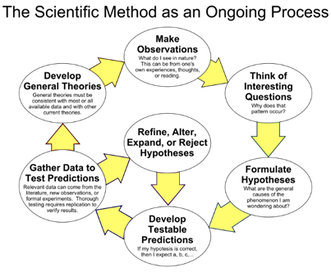
Data Driven Scientific Method for the Path to Solve Challenges

Slide 43
Scientific Method Applied to Firmware
Make Observations
View the origin of the condition and trace the path to current state.
Understand and collect evidence, experiments, and correlation needed for usage. The process will involve understanding underlying mechanisms and system interactions to classify the failing case. The development of the failing case will involve understanding the control flow and data flow graph with the behavioral expectation to the error classification.
The general failure condition will show a trace of valid conditions until one is not met in the flow such that the coverage of all cases are depicted in a manner such as Boolean algebra, truth tables, sequence diagrams, finite state machine (deterministic finite automata), etc.
Clarify the focused experiment, cases, and predictions for the root cause. Gather data to conclusively replicate the failure or conditions that lead to such a situation.
Define the problem.
Think of Interesting questions
Understand necessary analysis data.
Identify paths for further investigation.
Create a strong correlation in the concerning area.
Formulate Hypotheses
The developer will cultivate and expand a hypothesis on the finding to give exact clarity to confirm defect based on analysis and usage of data.
Specify the requirements and identify variables violated in the defective case.
When resources or strategies are exhausted create a brain storming session or working group to further understand failure to develop a collective hypothesis or explore mechanisms until a relevant formulation is reached. In the event, of a hard failure note it so further investigation can continue.

Slide 44
Scientific Method Applied to Firmware
Develop Testable Data and Predictions
Based on evidence, investigate the fault area beginning to formulate a predictive mechanism or existence of defect in design.
Refine, Alter, and Expand
Upon proving the root cause of the failure, the developer will understand and propose solutions based on the architecture and implementation to address the concern and maintain future extendibility.
Build a prototype solution to test defective case proving solution definitively resolved the original defect.
Before completing the solution, ensure the requirements are met and communicate results to technical lead, system technical product lead.
The solution will follow the standards defined for the product library and appropriate reviews before promoting to live library testing.
Refine, Alter, and Expand, or Reject
After failure case resolution, communicate the resolution case where the solution will be tested in an independent controlled environment the failure was produced in confirming the solution is appropriate in the common product library.
Accept
Solution is determined to be adequate for test case and corresponding horizontal technical leads should be made aware of the item resolution.
Follows to the solution that alter the architecture or expose failure conditions must be communicated to forward looking teams in a functional change in the ASIC, Firmware, Media, and or Tools.

Slide 45
Proposed Method for Exit Criteria on Fault Analysis
Review with TPL, Team, and/or Domain
Post results within JIRA clearly and concisely
Add content to debug wiki handbook

Slide 46
Scaling NSG Big Data

Slide 47
Can the BKM process for TWIDL parsing handle Telemetry? No
Telemetry introduces a large amount of data structures to track (288 for now)
The former process to add a data structure would take:
Incremental 3 days means at least 3 years of work
New 2 weeks means at least 11 years of work
When traversing the data object construction our inheritance causes a large amount of recursion.
The evaluation below is for a single telemetry object creation from C to python C-type.
Data object average depth d is 4 and items within z is 26
The a single data structure upper bound is a range of (1 to z)
Recurrence relation for an object
S(2) = h * (S(1) + S(0)), S(1) = j * S(0), S(0) = z
S(2) = h*((j+z)(z)) = (h*z*j) + (h*z*z) = h*z²+h*j*z
Assuming h=j=z then S(2) = z³+z³ = 2z³
Therefore: S(d)=d*z^{(d+1)}
Worst case is: y = max(h,j,z) then S(d) = d*y^{(d+1)}
Average case is: probability of (n choose 1) is n then S(d) = d*n
Best case is: y = h = j = z = 1 then S(d) = d*1⁽¹⁺¹⁾ = d
Average case estimate for lines of python code (best = 296,064 avg. = 8,985,600, worst = 3,421,837,440) using empirical constants (d = 4, z = 26)
Using the average case above 104 python code for one object parser!
We have 288 objects so 29,952 lines of python for C-Type object definitions for just one major and no minor!
For each API, the C-Type, tracking information, and printer function so 3 times that code for 89,856 lines!
Low estimate producing 8,985,600 lines of code for what we have to parse structures today!
To make matters even worse we have objects that have double digit majors and minor versions!
To put items in perspective the lines of code for some known project is at https://en.wikipedia.org/wiki/Source_lines_of_code
Year | Operating system | SLOC (million)
1993 | Windows NT 3.1 | 4–5^{[2]}
1994 | Windows NT 3.5 | 7–8^{[2]}
1996 | Windows NT 4.0 | 11–12^{[2]}
2000 | Windows 2000 | more than 29^{[2]}
2001 | Windows XP | 45^{[3][4]}
2003 | Windows Server 2003 | 50^{[2]}

Slide 48
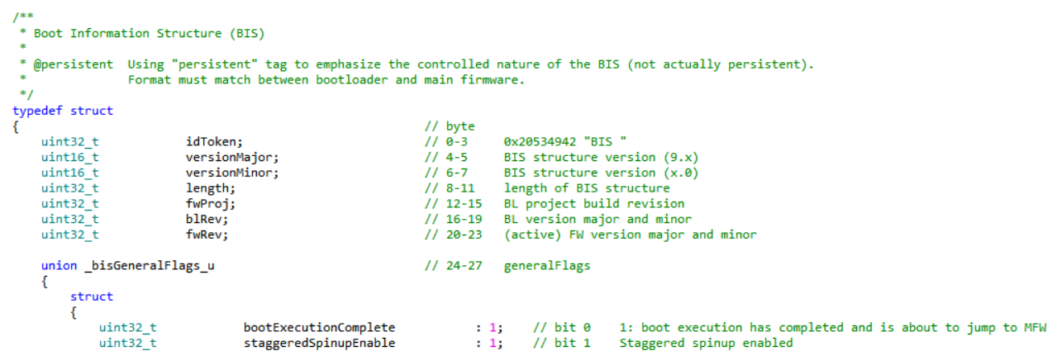
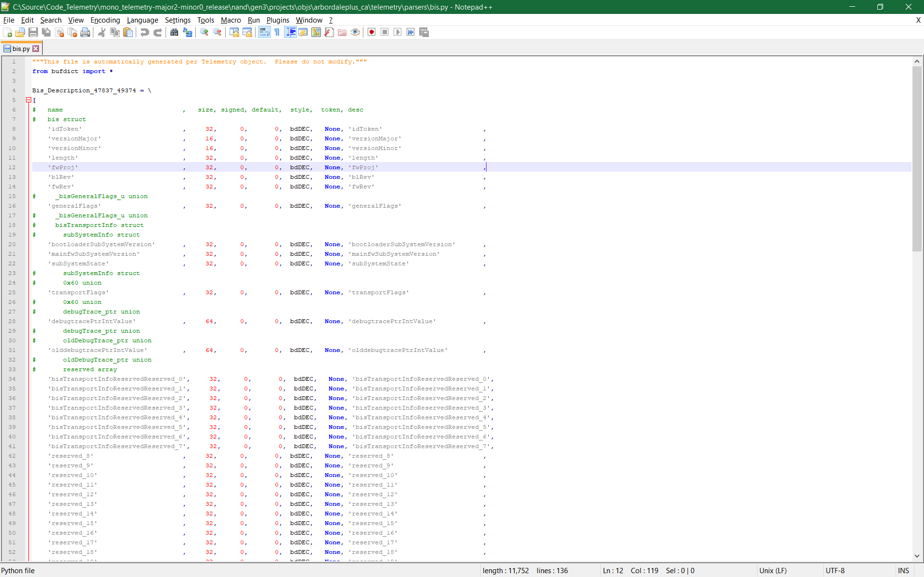

Vision of Data Mapping Access Hierarchy for Auto Parser
Goal – Text parsing map of firmware data structures within the telemetry, assert, event dump(s) without the compiler.
Project Code Name: PacmanIC.py

Slide 49

PacMacIC.py Tool Chain Flow (Preview)
Data Extraction Script Flow
Auto C to C-Type Compiler Flow

Slide 50
External Tools

Slide 51

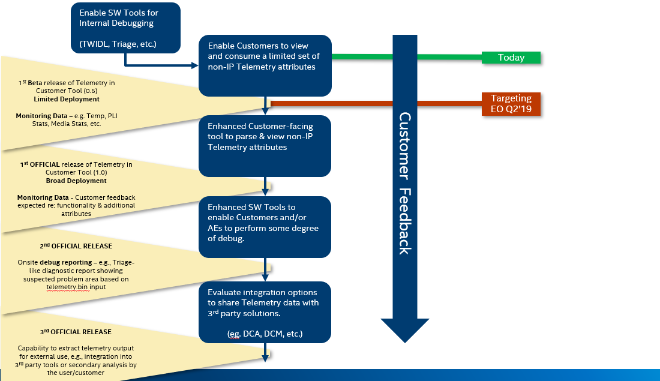
External Tools - Strategy
Notes:
It shows a flow diagram of the process, the actions required, and the communication.
1st Beta release – Rev 0.5 – End of Q2_2019 – limited attributes and limited customers (DellEMC, Ali, Baidu and Tencent)

Slide 52

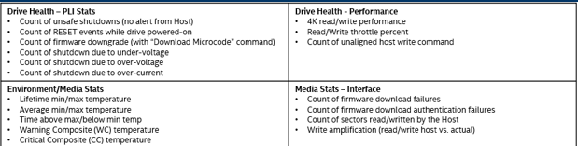
External Tools
Following Tools can be used today to pull the Telemetry log from the device
Intel® SSD Configuration Manger (iSSDCM)
Intel® Quick Screen Tool (QST)
NVMe-CLI (Linux/Open Source Tool)
Intel® Memory and Storage Tool (iMAS)
Development is WIP
1st release (Rev 0.5; end of Q2) will provide basic Telemetry log parsing and display of the following. The FW won’t track trends or averages.
Notes:
Deliver “tokenized” library to tools team WW20.3 (May 15, 2019)
Customer tool that accepts InputFile = telemetry.bin and outputs (e.g., display, json, download…) subset of telemetry data
1st tool demo (NSG internal only) WW23.3 (June 5, 2019)
2nd tool demo (NSG internal only) WW26.3 (June 26, 2019)
1st Beta release (version 0.5 for limited customer testing/evaluation) WW28.1 (July 8, 2019)
2nd official release (version 1.0 for wide customer release/use) WW40.1 (Sept 30, 2019)

Slide 53
References
Internal:
Wiki page
External:
Part #1 on Telemetry BLOG: https://itpeernetwork.intel.com/telemetry-enhancing-customer-triage/
Part #2 on Telemetry BLOG: https://itpeernetwork.intel.com/telemetry-use-cases/
A comprehensive whitepaper will be published in end of Q3_2019 DCG platform level Telemetry BLOGs: https://itpeernetwork.intel.com/know-your-data-center/
Groups (Joe Tarango, Lead)
Developer Divide and Conquer Open Forum
Customer Engineering
Telemetry Escalations
Telemetry Architecture

Slide 54
Part 2 – Additional Tools, Data Control, Additional Content Injection, Security, and Process, and Operational Consideration

Slide 55
Objectives
Triage for Internal Usage
Payload Extract and Partition
Auto Parsing with Telemetry Tools
Developer Scripts
Data Control
Source
Identifier and Requirements
Structure Tracking Details
Handling Saved Data
Segmenting Files
Architecture Flow
Adding Content
Structures and Functions
Addition Steps
Data Content Security
Classification
Auditing
Telemetry Data Content Addition Process
Performance and WAF Considerations

Slide 56
Advanced Telemetry Tools

Slide 57
Triage for Internal Usage
Allows for capturing and parsing of portions of the Telemetry binary log
Should be used by AEs, Devs, TSSs; only internal;
>Triage.exe –t <Telemetry.bin> --testball <path>
The tool currently parses the following data objects:
nLog (Both NAND and Optane)
Assert Dump (Assert Dump header and nLog)
Event Dumps (Event Dump header and nLog)
Sidetrace - may not be included depending on the fault
APL nLog
APL Crash dump (On Linux systems only)
Ongoing, iterative enhancements for V2 Telemetry version will add additional parsing & analysis over time. It’s WIP.

Slide 58
Telemetry Payload Extract and Partition - Dev
Triage Extract (NSGTools)
python triage.py --gettelemetry
python triage.py -t telemetry.bin
Developer (\telemetry)
Python getTelemetry.py -d 1 sample.bin –nvme
Additional Option
Host initiated log “—hi” (default)
Controller initiated log “—ci”
Developer Separate eUIDs (telemetry)
parseTelemetryBin.py sample.bin -o sample --debug > telemetryGetAndParse_log.txt 2>&1

Slide 59
Parsing with Telemetry Tools

Slide 60
Auto Parser aka PacMan I See Py
Location
telemetry
Usage
python ctypeAutoGen.py --verbose --projectname product_ca --fwbuilddir ..\product_ca --tools .\ --multiexeversion multi_616 > telemetryGenParse_log.txt 2>&1
Produced File Location
product_ca\telemetry
Parser Dictionary location
telemetry\parsers

Slide 61
Vision of Data Mapping Access Hierarchy for Auto Parser

Slide 62
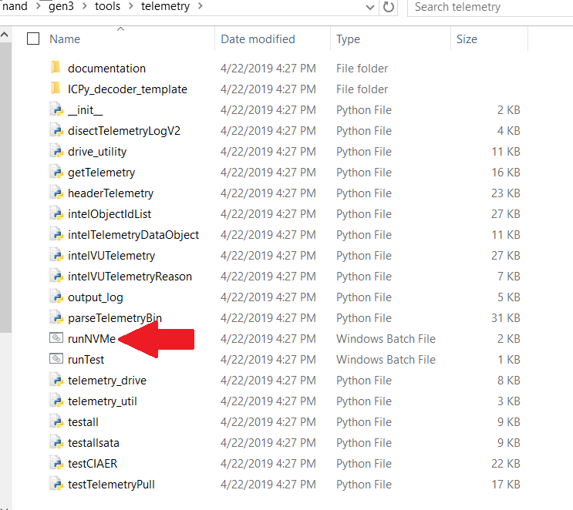
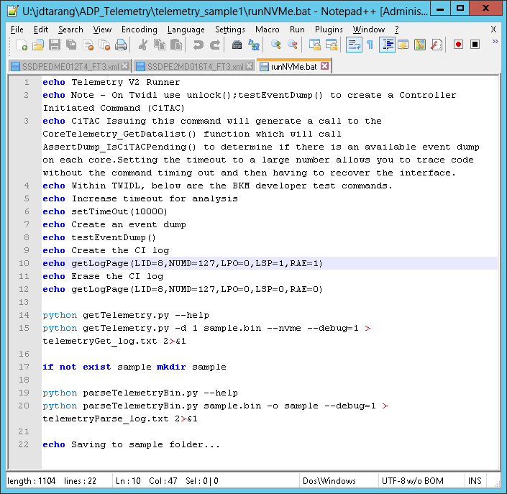
Telemetry Developer Scripts

Slide 63
Data Control

Slide 64
Data Control Structures for Telemetry
Source Code
ssddev\nand\gen3\src\datacontrol.h
ssddev\nand\gen3\src\datacontrol.c
Data Information
Identifiers
eUniqueIdentifier
NAND tracking information
dataControl_t dataControlTable[]
Telemetry V2 Header
telemetryObjMapEntryV2_t pool[]

Slide 65
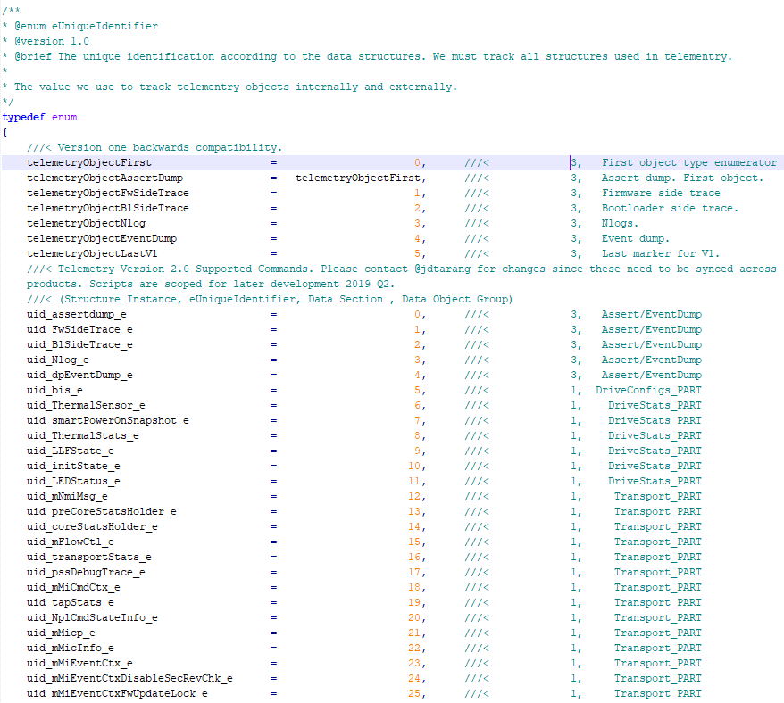
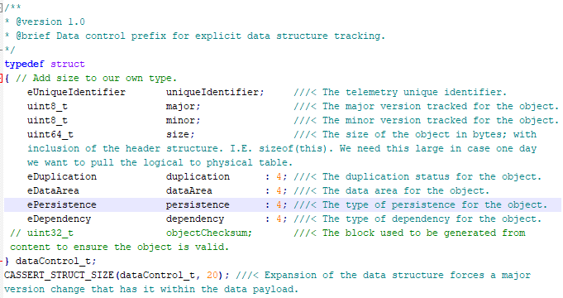
Data Control Identifier and Requirements
Each identifier requires:
Uniqueness
Retiring structures are agnostic
New Structures added to Telemetry require new assignment
Data must be tracked
Major – Structural definition is novel
Minor – Extensions by appending
Size – Minimal with extendibility pad, each increase should follow constraints of all products

Slide 66
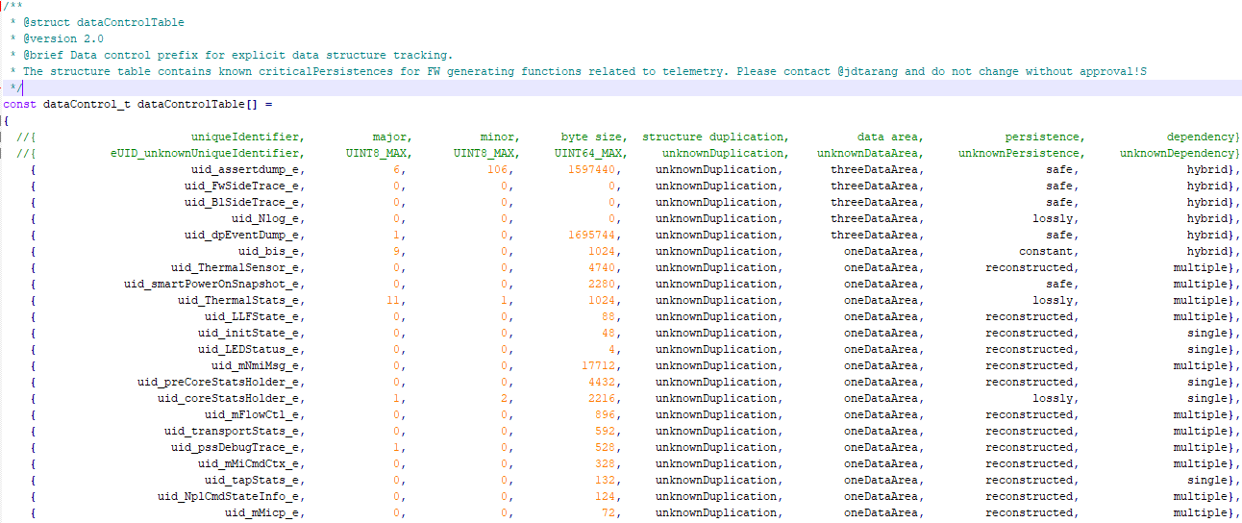
Data Control Structure Tracking Details

Slide 67
Handling Saved Data

Slide 68
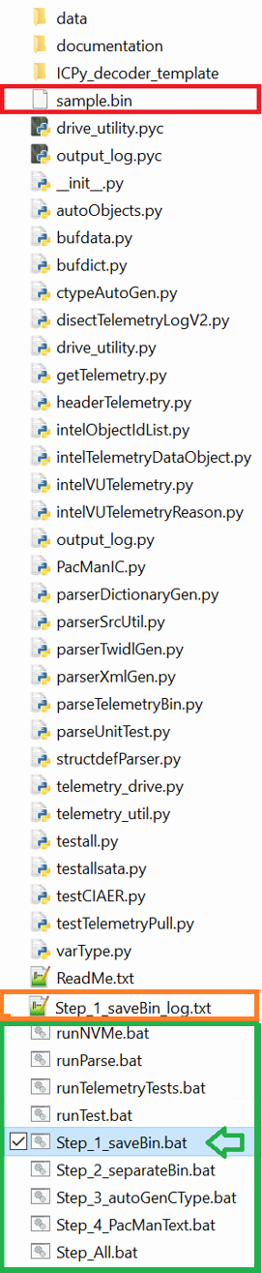
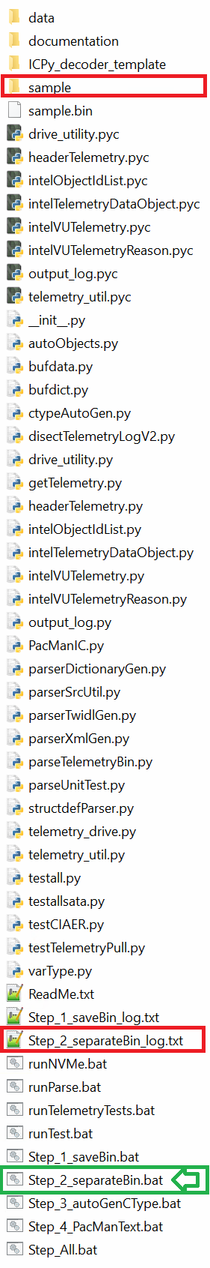
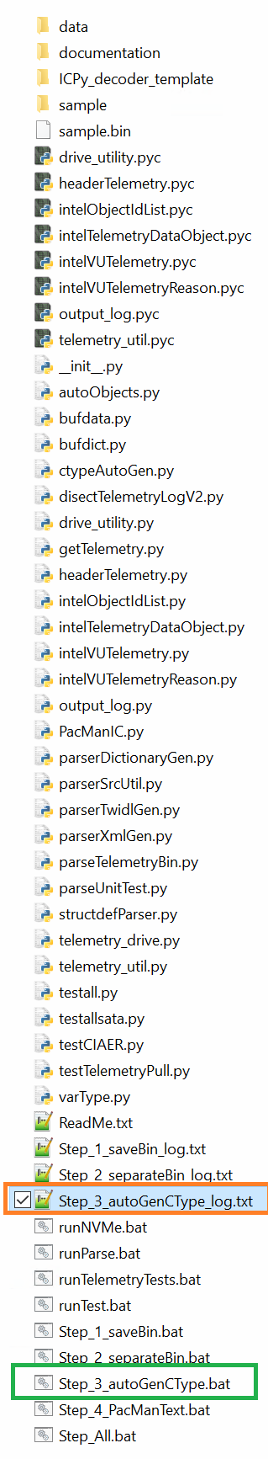
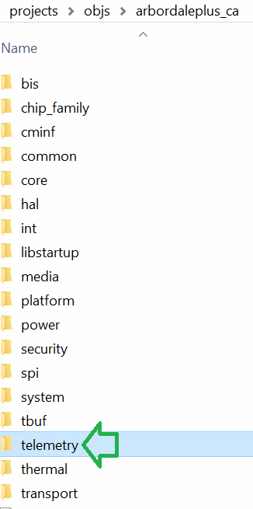
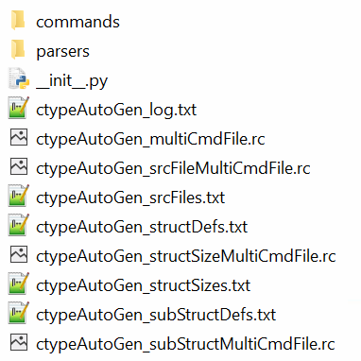
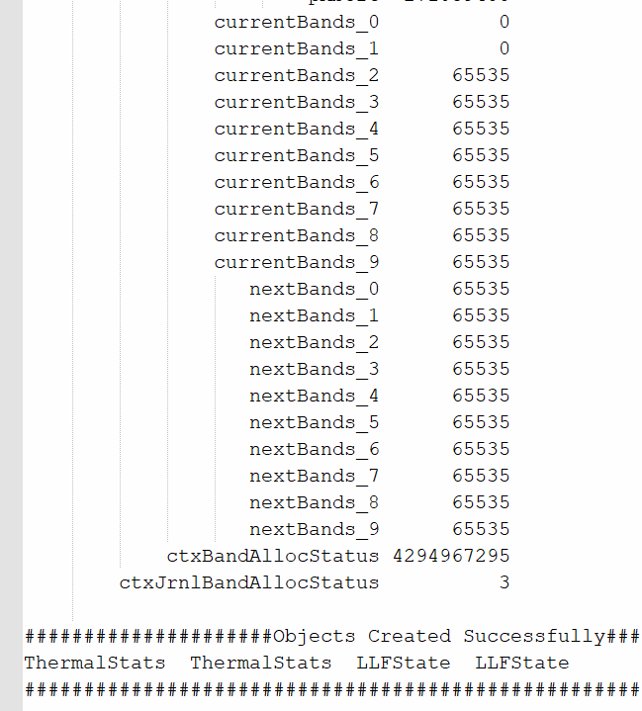
Telemetry Data Saved
Steps 1-3
Script Sample Binary
Sample.bin (red, middle)
Telemetry binary payloads
Simulator Loading Script
Sample Folder (Orange, top)
Segmented data objects
Telemetry*_log.txt
Developer debug parsing logs for sample folder.
AutoGen creates a folder within the specific project “telemetry”
The folder contains:
Logs – Logs for the phases of the generation
Parser – Generated python C-type decoder
Command – API interface
PacManText.bat used the *.bin to output text.
AutoGen folder
AutoGen parser
Pacman text

Slide 69
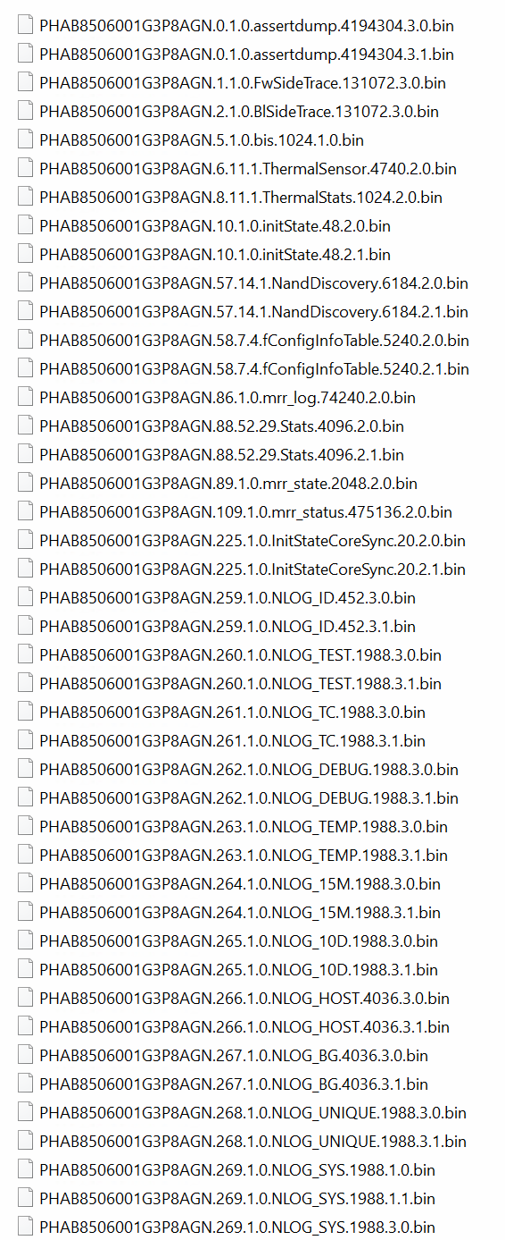
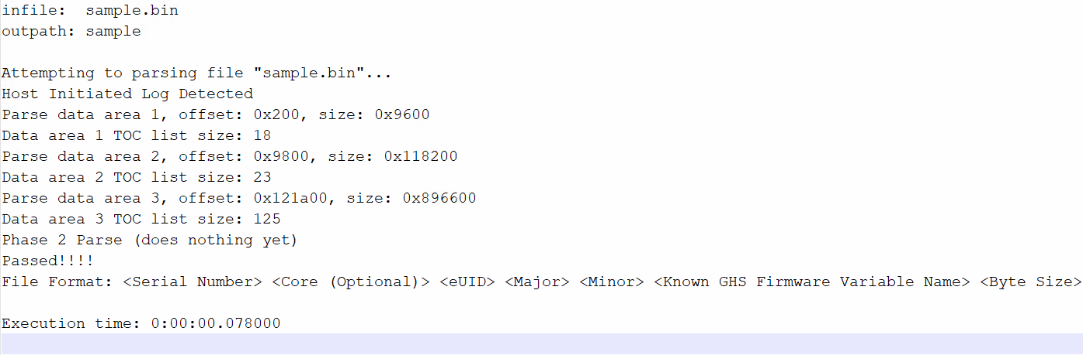
Telemetry Segmented Files Part 1/3
Telemetry generates numerous files
Depending on the objects in the list
For host initiated, the event dump is only included if one exists.
When multiple event dumps exist back to back a controller initiated event will occur if the feature is enabled
Each object is parsed into segments
Format (Subject to change and within listed in log file)
<Serial Number> <Core (Optional)> <eUID> <Major> <Minor> <Known GHS Firmware Variable Name> <Byte Size>

Slide 70
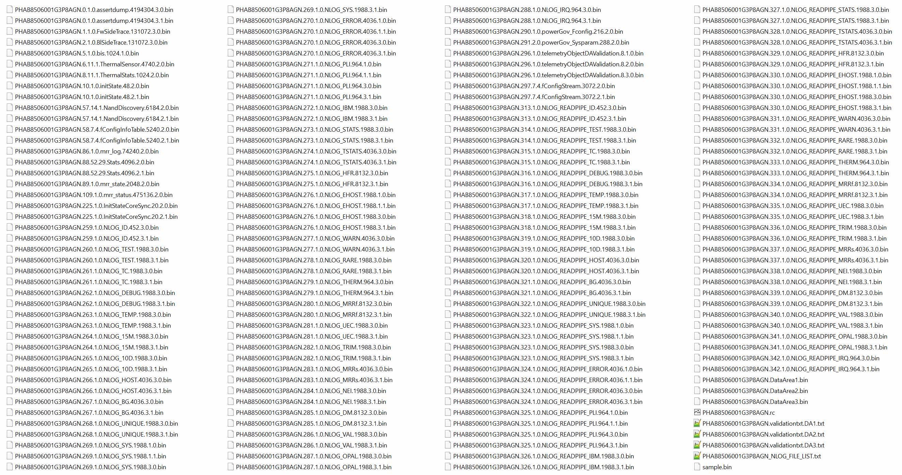
Telemetry Segmented Files Part 2/3

Slide 71
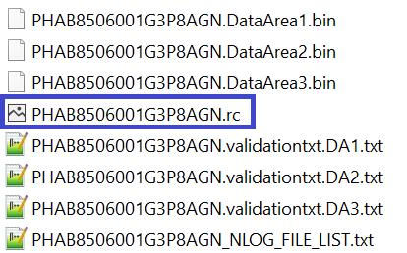
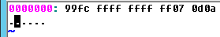
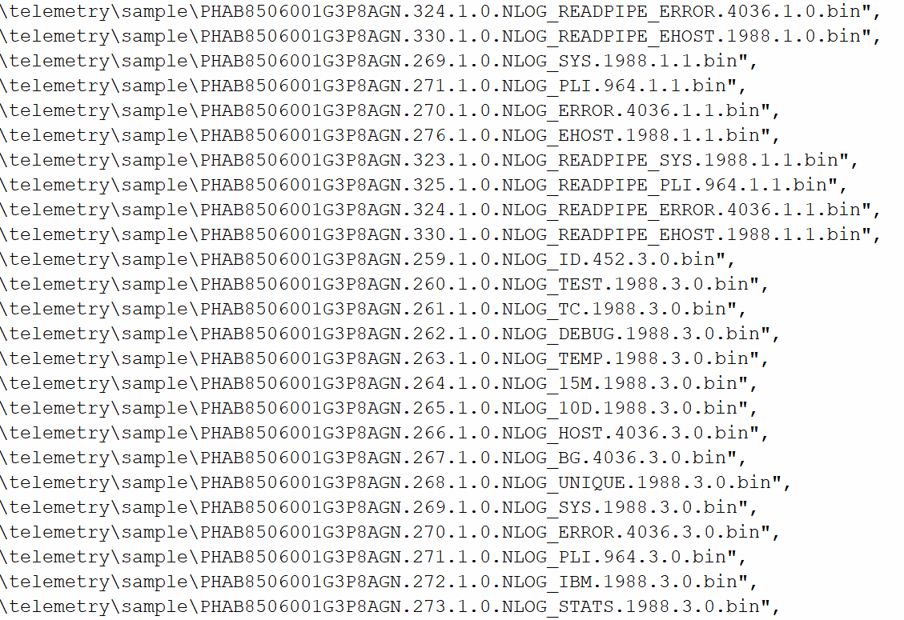
Telemetry Segmented Files Part 3/3
After each individual object
Slices of data areas are included
Sim load Script (blue)
Each data area has a static token
Serial Number, “validationtxt”, Data Area #
0x99FC FFFF FFFF FF07 0D0A

Slide 72
Architectural Flow

Slide 73
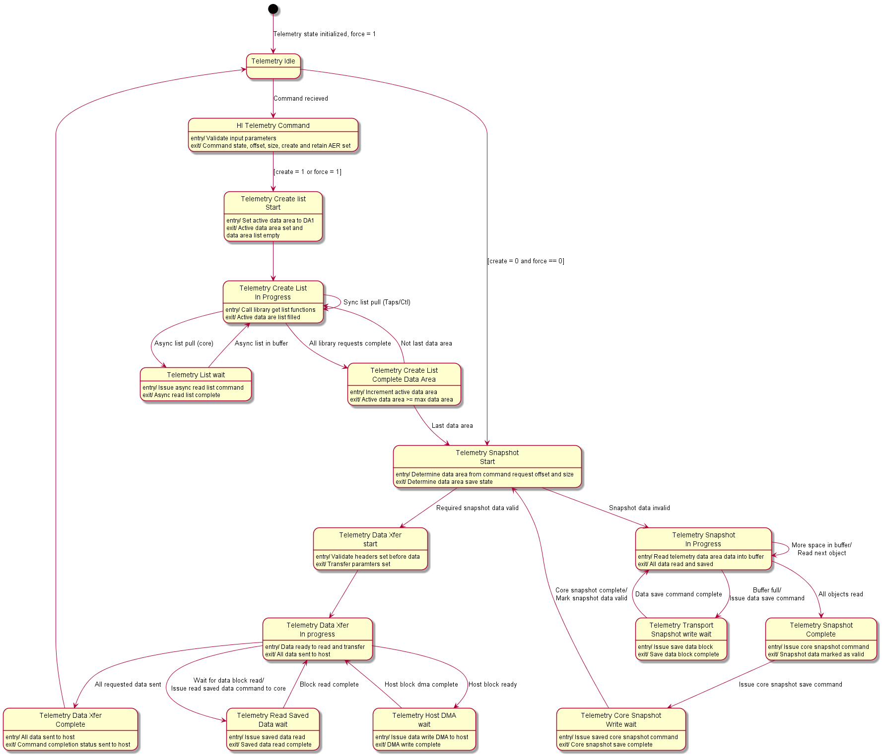
Telemetry Command Finite State Machine (FSM)
Pertinent States
Create list
Queries each module for their respective object(s) desired to send
Snapshot
Blob and drive param saves of objects
Transfer Snapshot
Post saving content the data objects are retrieved from the time instance of the request

Slide 74
HiTaC

Slide 75
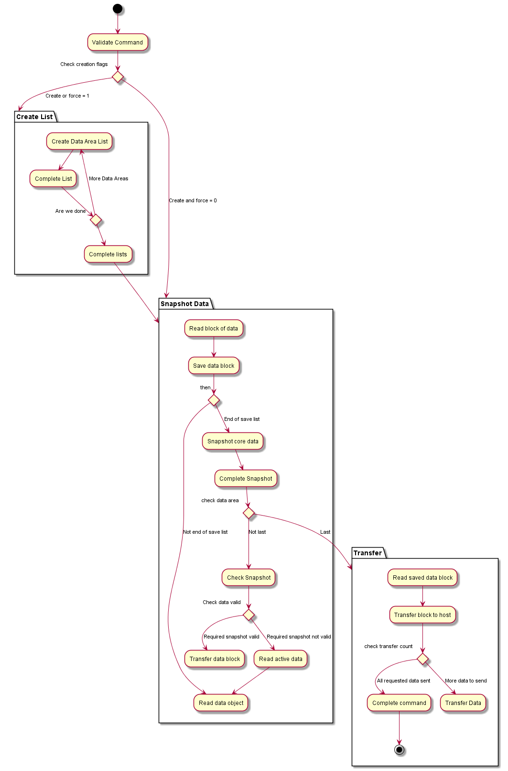
Host Initiated Telemetry Get Log Page Activity Diagram
HiTaC
Creating the lists are dynamic to the product
Snapshot of the data is pieced into the respective:
Blob identifications
Drive parameter identification
Transfers are limited to the staging buffer
Objects are padded
Data areas are padded to boundary.

Slide 76
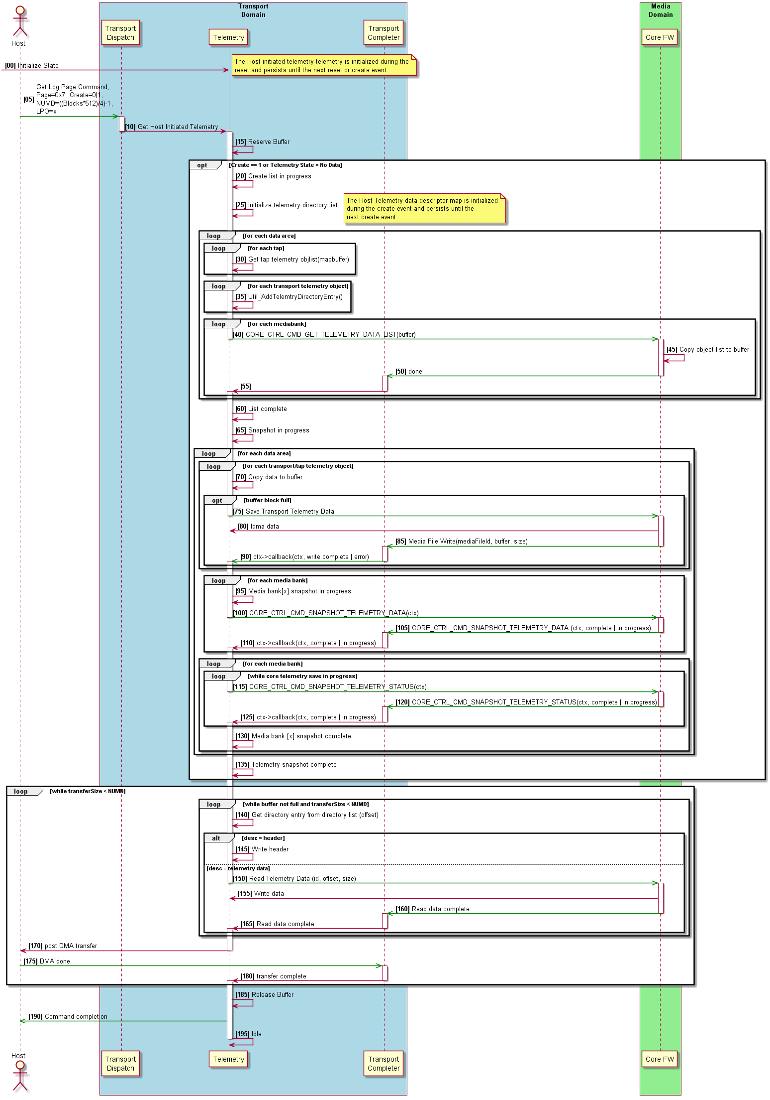
Host Initiated Telemetry Get Log Page Sequence
Transport Layer
List directory collection
All data areas
Modules (Transport, Core, Platform Services, etc.)
Send list
Data area lists
Transport Layer
Collect data
Allocate staging buffer
Transfer to general purpose buffer
Core
Copy data to identification locations
Trigger data to blob or drive param

Slide 77
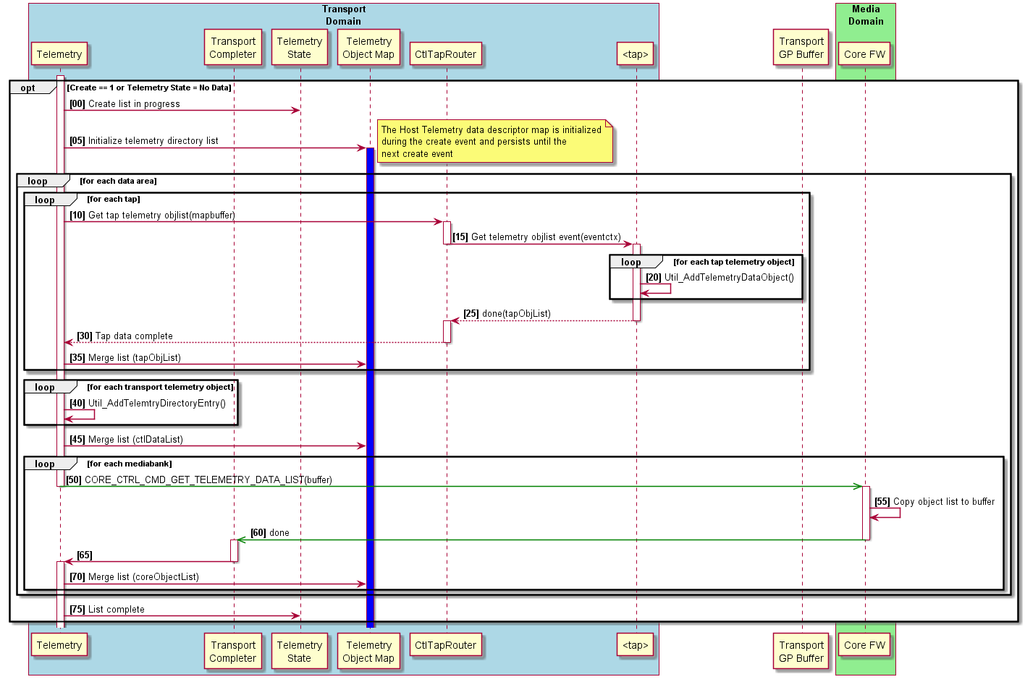
Create Host Initiated Telemetry Object List Sequence Detail
After creation of the list, the data is persistent until the persist flag is remove
Walking of the map buffer each TAP creates its own sub-lists
All of the lists are merged into the dynamic list for the time instance

Slide 78
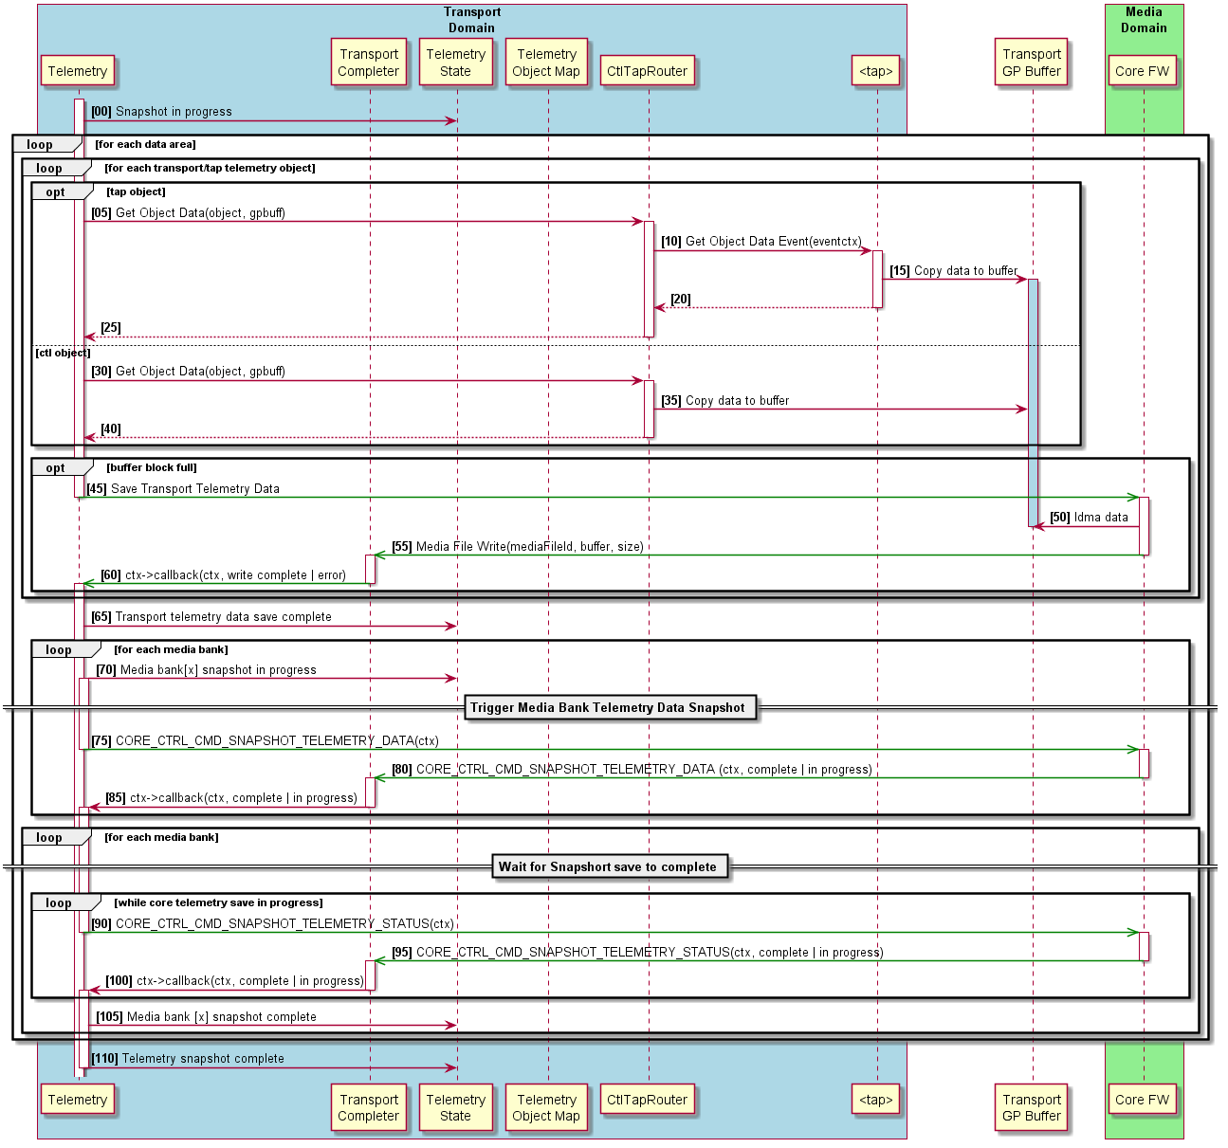
Host Initiated Telemetry Transfer and Snapshot Data Sequence
Each data area contains it own reserved save location
On snapshot, each of the objects in the list are copied to the staging buffer until is filled
On fill, a save is triggered the process is repeated
For multiple media bank products, the transport layer requests for each bank.

Slide 79
CiTAC

Slide 80
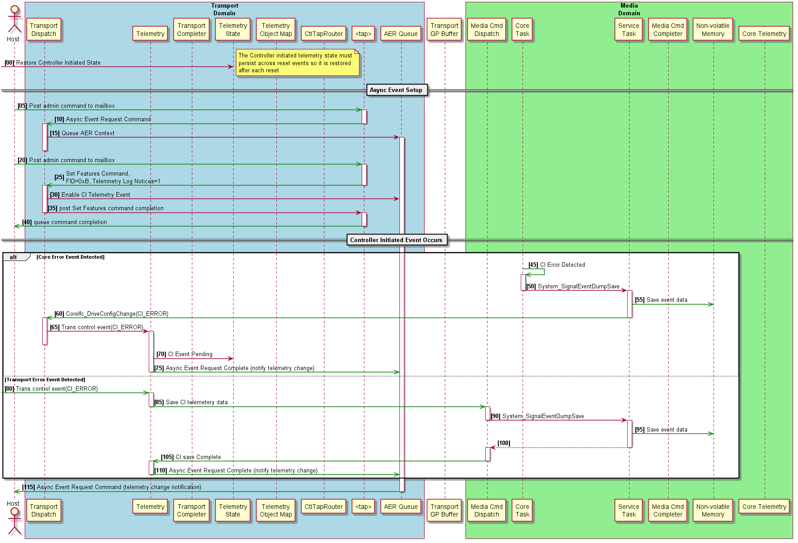
Controller Initiated Telemetry AER Trigger Sequence Details
CiTAC is driven by the device
The state is persisted across power cycles
Asynchronous events requests (AER) require setup to be used by the host
When an event occurs, the device triggers the assert or event save
On save complete, the transport receives the notification TAP
The TAP notifies the host request though the AER

Slide 81
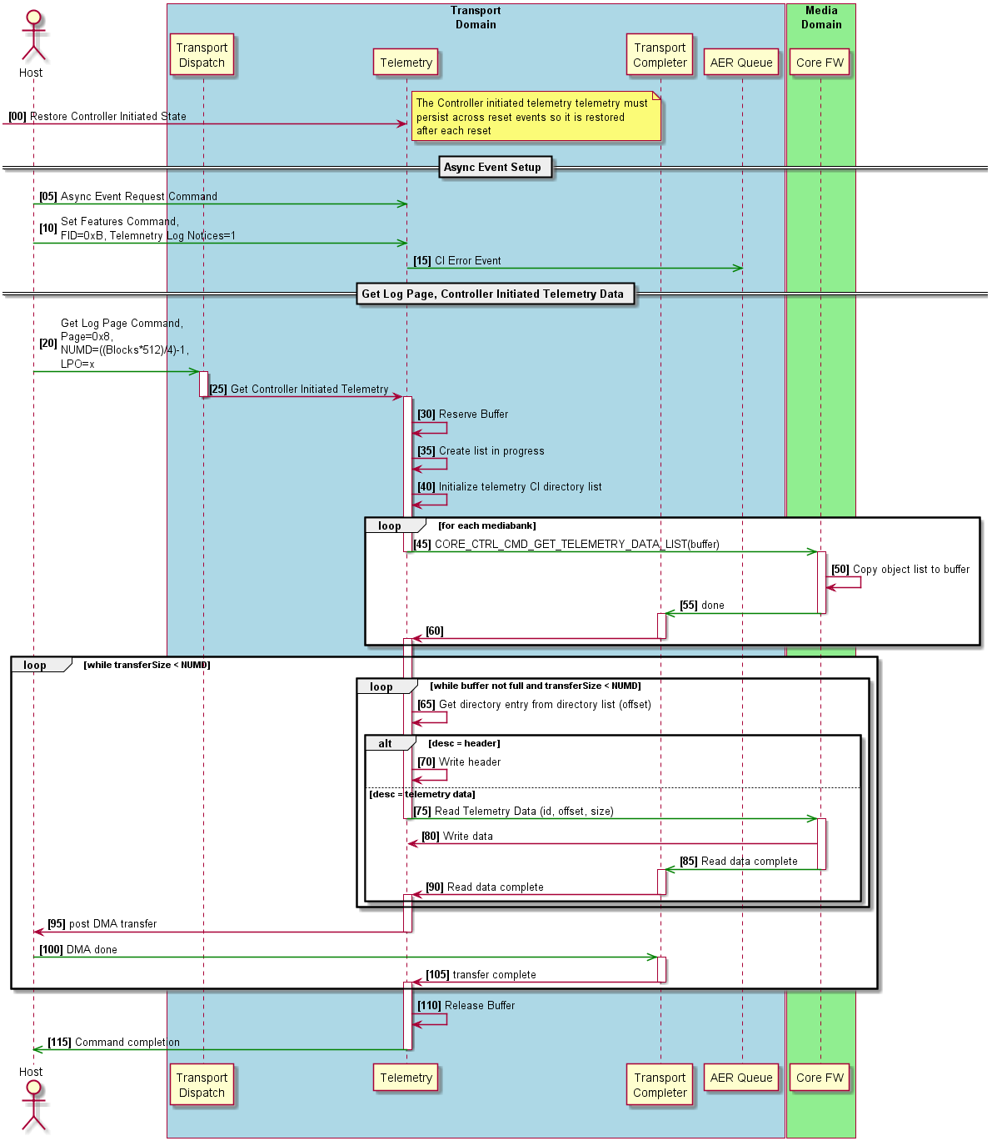
Controller Initiated Get Log Page Telemetry Sequence
The AER is persistent until the host clears the event
The host can clear the AER at any time deleting the blocks
To get the fault data the host reads the data blocks
On Host TAP event
Creates the data area 3 list.
Asynchronously notifies the host
On host transfer request, the controller
The list queries the system for the saved objects
Transfers the requested blocks
On event clear, the event is cleared
On the existence of multiple events, the CiTAC will repeat the sequence above until all events are cleared by the host

Slide 82
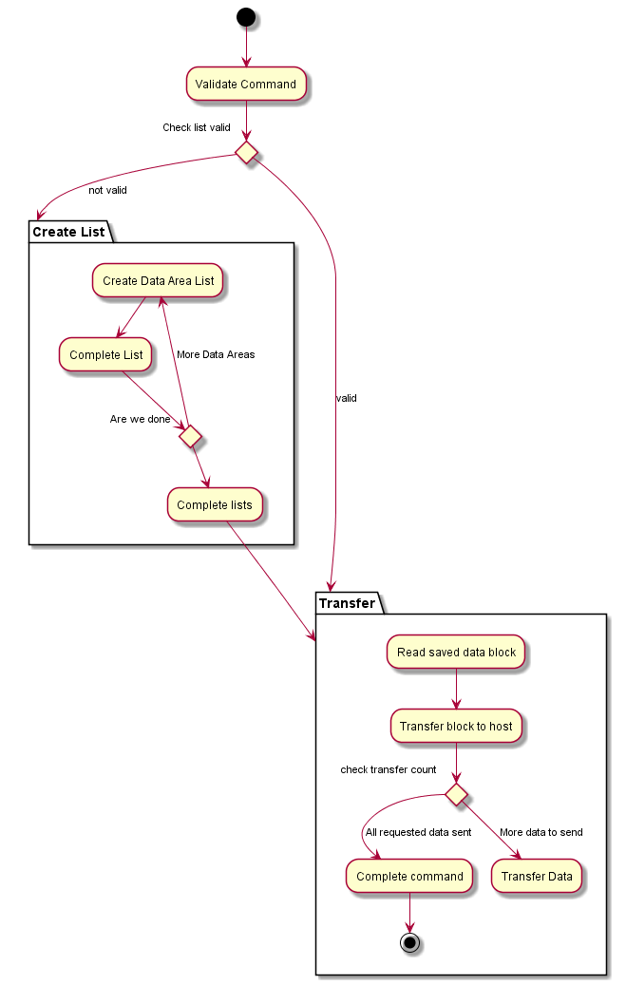
Controller Initiated Get Log Page Telemetry Activity Diagram
CiTaC
The controller list can be different than host
Creating the lists are dynamic to the product
Snapshot of the data is pieced into the respective:
Blob identifications
Drive parameter identification
Transfers are limited to the staging buffer
Objects are padded
Data areas are padded to boundary.

Slide 83
Adding Content

Slide 84
Developer Additions Steps
Register Object in
Firmware module/library within the initialization path of that library only called once
Create Fill destination API
Core Interface
Transport Interface
HAL to Transport Interface
Snapshot Save
Create drive parameters addition save or data blob

Slide 85
Data Content Security, FIPs, and Process

Slide 86

Security Data Classification
Guidelines - https://employeecontent.intel.com/content/corp/infosec/policies.html
Documentation - ssddev\nand\gen3\tools\telemetry\documentation
Security Risk Types
Data exposed to customers or the world.
Sensitive data relates to Intel secret or IP not protected by patent
Data object explanation
Each data structure should have a brief for the entire item and each element will need to be explained.
We need to list the units for each of the items with the base number I.E. base 2, base 10 mathematics, seconds.
Persistence type as defined by ePersistence in datacontrol.h I.E. constant, critical, lossly, reconstructed, etc.
NSG specific security context information
Security context information for the RNG/DRBG data. This includes ANY of the entropy data, DRBG internal data structures, etc.
Any of the firmware implemented algorithms such as CTR-DRBG
Any structure containing a user data payload with relation to admin commands, specifically security send a receive
I.E. DMT has an scx for SR so there the keys to the castle are there.
All key material data structures related to:
Fuse data containing things like the root key
PSID
Opal Passwords
UART passwords
TCG technology family (Opal, eSSC, Pyrite, etc.)
ATA security
Ephemeral keys
Plaintext keys in DRAM
https://employeecontent.intel.com/content/corp/infosec/home.html

Slide 87
Data Security Audit Process (WIP)
Data Extraction
Method to access command to gather all secure data bytes and definitions
Similarity Search Audit Verification
All pairs compare of object bytes of secure data sets to telemetry payloads
Input: All security Data, Telemetry
Output: Grade of likely-hood we have leaked information
ConVal
Each product executes a swim lane to verify content does not escape
Release Checkpoint
Review detections over configuration similar require DRB presentation from product security lead to domain forum.

Slide 88
Telemetry Data Addition Process

Slide 89
Telemetry Data Addition Control Process
Review Security Guidelines for Data Control
Determine if the data meets the guidelines
Contact: Jim Baca, Randal Eike, Joe Tarango, Gamil Cain
Schedule Telemetry Working Group Meeting
Presentation
Usage Development and/or Business requisite
Review Control/Data Flow (C/DFG) and Data of the Object Desired
Showcase the usage and impact
Provide urgency of deployment and stakeholders
Timeline for internal and/or external release
Domain Reviewers
Allocate eUID to Sync Across products
Verify telemetry swim lane functionality and auto generation parser functionality with trackable tidbits link
Allocate Time
Live code review
Data extraction demonstration by walking through the C/DFG code path in Debugger
Request Code Promotion
Once code pushed, dispatch notification to stakeholders

Slide 90
Performance and WAF Considerations

Slide 91
Performance Considerations (Internal profiling)
Workload Analysis
Impact analysis on data section 1 and 2
Telemetry Creates Snapshot (capture the data into a Telemetry blob on media)
Frequency Limitations (time)
Micro seconds, mili-second, second, minute, hour, day, week, month, and year
IOPs and QoS for continuous polling
WAF for in the field usage due to additional write to the system band for NAND (for 3DXP, they are in FASTCTX files)
Optional (set limits for ConVal)
Command completion tracking. From initiation of the command, we should know the time to completion for each telemetry query related to the section set requested.
Notes:
It’s for internal profiling only; We would not recommend expecting this data to be shared outside of product WAF constraints from Sis. Completion tracking is only for internal usage; the following is exclusively for analysis internally.
1-3. One of the things still left to evaluate is the actual impact on I/O performance of generating and transferring telemetry data. It should be minimal but we have not been able to measure it on all products yet. Obviously there is no impact if the host is not issuing the get log page command. But when the host does there will be a slight drop in performance while the drive processes the telemetry command.
The I/O performance impact is due to the fact we need to save and read the snapshot (takes some NAND BW) and the general processing required to assemble the data (takes core BW).
4. That was for the ConVal tool to track the command time to measure “how long it takes the drive to respond”.
Right now we have no limits, but we should probably set some loose limits in the near future.

Slide 92
Part 3 - Advanced Analysis Technique(s)

Slide 93
Objectives
Diligent Engineer Behaviors
Data Driven Scientific Method
Debug Handbook
Fault Analysis BKM(s)
Procedure for Fault Analysis
Definition Table
Exit Criteria and Debug Handbook
Fault Analysis Example(s)
SR003
BM453
Silent Fault Data Capture
System Simulation Mode
No Assert or Event Dump Script Setup
Virtual Data Loading
Viewing Content
Assert or Event Dump Script Setup
Assert Dump Loading
Content Verification
Sharing Developer Content
Debug Snapshoting
Striving for Predicable Outcomes

Slide 94
Diligent Engineer Behaviors
Disposition of customer fault by:
Bound the problem(s)
Determine root cause(s)
Create appropriate solution(s)
Communicate across the stakeholder(s)
Retrospective mitigation to reduce exposure. Intention is to characterize asserts in a way that we can understand the failure impact such that we can decide if there are opportunities to:
Eliminate the assert
Add handling to recover
Fail in a controlled and encapsulated manner
Rework the assert or fault logic to narrow the failure conditions
Functional verification includes: module state, control flow location, event dependencies, and data flow dependencies
Notes:
Priyanka

Slide 95
Review of Scientific Method for the Path to Resolve Data Driven Challenges

Slide 96
Scientific Method Applied to Firmware
Make Observations
View the origin of the condition and trace the path to current state.
Understand and collect evidence, experiments, and correlation needed for usage. The process will involve understanding underlying mechanisms and system interactions to classify the failing case. The development of the failing case will involve understanding the control flow and data flow graph with the behavioral expectation to the error classification.
The general failure condition will show a trace of valid conditions until one is not met in the flow such that the coverage of all cases are depicted in a manner such as Boolean algebra, truth tables, sequence diagrams, finite state machine (deterministic finite automata), etc.
Clarify the focused experiment, cases, and predictions for the root cause. Gather data to conclusively replicate the failure or conditions that lead to such a situation.
Define the problem.
Think of Interesting questions
Understand necessary analysis data.
Identify paths for further investigation.
Create a strong correlation in the concerning area.
Formulate Hypotheses
The developer will cultivate and expand a hypothesis on the finding to give exact clarity to confirm defect based on analysis and usage of data.
Specify the requirements and identify variables violated in the defective case.
When resources or strategies are exhausted create a brain storming session or working group to further understand failure to develop a collective hypothesis or explore mechanisms until a relevant formulation is reached. In the event, of a hard failure note it so further investigation can continue.

Slide 97
Scientific Method Applied to Firmware
Develop Testable Data and Predictions
Based on evidence, investigate the fault area beginning to formulate a predictive mechanism or existence of defect in design.
Refine, Alter, and Expand
Upon proving the root cause of the failure, the developer will understand and propose solutions based on the architecture and implementation to address the concern and maintain future extendibility.
Build a prototype solution to test defective case proving solution definitively resolved the original defect.
Before completing the solution, ensure the requirements are met and communicate results to technical lead, system technical product lead.
The solution will follow the standards defined for the product library and appropriate reviews before promoting to live library testing.
Refine, Alter, and Expand, or Reject
After failure case resolution, communicate the resolution case where the solution will be tested in an independent controlled environment the failure was produced in confirming the solution is appropriate in the common product library.
Accept
Solution is determined to be adequate for test case and corresponding horizontal technical leads should be made aware of the item resolution.
Follows to the solution that alter the architecture or expose failure conditions must be communicated to forward looking teams in a functional change in the ASIC, Firmware, Media, and or Tools.

Slide 98
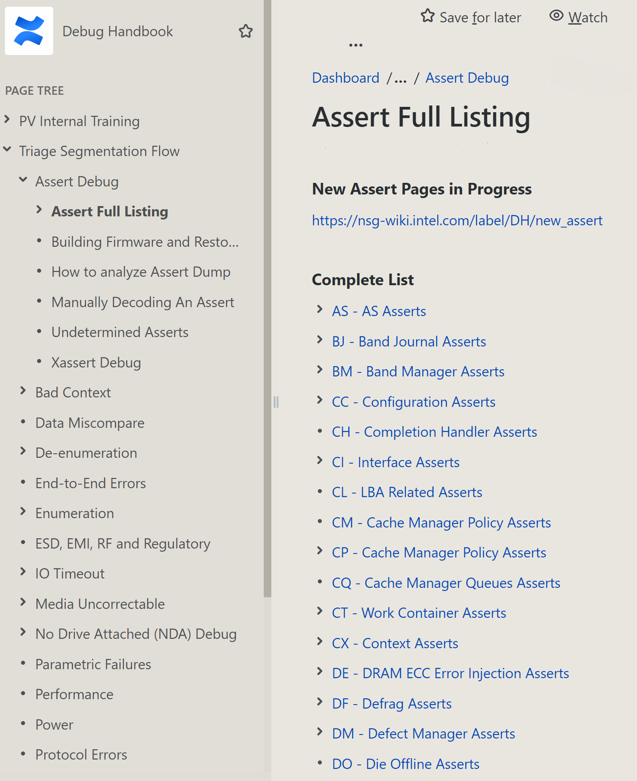
Fault Analysis and Debug Handbook
Development Flow
Starting Wiki
Navigate through the document tree for related fault.
Guided Live Analysis through Customer Engineering Group
Contacts: Joe Tarango and Mike Ton
Be prepared with problem statement, firmware, and data loaded in simulation; if possible.
Adding Content
To access the Debug Handbook assert documentation template
Click the "..." blue button next to the "Create" button at the top of the page.
Select the "Assert_XX### Debug Template" option.
Operation will open a blank template to populate with assert documentation.
The template includes a JQL JIRA search query for the given assert code
Outline of Creation
Summary of Challenge
Fault Category
Domain and Modules Impacted
Unique identifiers used for analysis.
Telemetry data control identifier.
I.E. Assert dump - uid_assertdump_e = 0

Slide 99
Fault Analysis BKM(s)

Slide 100
Procedure for Fault Analysis
Review NCT/JIRA
Determine the urgency state providing an cadence of evaluation I.E. update every day
Ensure data for analysis is provided
Triage data provided and verify content is usable
Summarize data provided
Acknowledge the behavioral challenge
Literature review NCT, JIRA, Wiki
Understand the failures seen so far.
Historical Analysis
Reproducibility
Time to Failure
Triage of known symptoms to cross correlate
Solutions to faults
Disposition
Problem statement
Disposition (Continued)
Known causes
Data dependencies from control-data flow dependencies CFG/DFG of fault. Limiting to plausible depth.
Firmware and Hardware component module dependencies. Includes registers, interrupts, and logical data structures.
Early binding
Is the fault close to the first order fault or is there a deeper dependency?
Anticipation mechanism
Ability to reconcile the condition path
Can the fault exist within the scope?
Data generation from scope of challenges
List explicit data structures
Notes:
Priyanka

Slide 101
Definitions of Tables
Assert or fault condition too loose?
Assert conditional is loose enough that it might be flagging some non-critical errors or API could have multiple callers with different criticality.
Recover or fail more gracefully?
Is there an opportunity to rework the firmware such that recovery is possible? E.g. for rare DMA transfer failures, re-dispatching the DMA rather than failing. Is there an opportunity to rework the firmware to fail more gracefully? E.g. marking a piece of data as uncorrectable and continuing operation.
Catastrophic?
Is there a 100% chance this drive is going to fail and count against AFR even if this assert is removed?
PLI hang exposure?
Is the assert guarding against the possibility of a hang during PLI save that would result in a BAD_CTX_2XXX failure? E.g. deadlock during PLI save, quiesce timeout, or HW hang scenario?
Silent data error exposure?
Is the assert guarding against the possibility of a silent data mis-compare that would impact SBER? E.g. most recent copy of sector data has been lost or we are bout to DMA data that has failed LBA/CRC checking.
Notes:
Priyanka

Slide 102
Definitions of Tables (Continued)
Seen at Customer?
Relates to if it is ASSERT_CUST or SoC abort condition
Assert condition loose?
Is the condition clear within the code.
Ability to recover of fail more gracefully?
Are there measures we can do in the future to reduce the occurrence or fault tolerance.
Catastrophic?
Will the drive at this point not maintain data integrity or relates to a hard system failure.
PLI hang exposure?
Will the condition block a PLI event or data coherency if a PLI occurs.
Silent data error exposure?
Is the event is not caused from a hard stop and relates to a series of events in the past.
Granularity of potential exposure to SDER?
Results in silent data error
Notes:
Priyanka

Slide 103
BKM for Exit Criteria on Fault Analysis
Complete Debug Template
Empty_Template_v1.docx
Example_Template_v1.docx
Review with TPL, Team, and/or Domain
Post results within JIRA clearly and concisely
Add content to debug wiki handbook

Slide 104
Example Fault Condition SR003
Evaluation Focal Points
Seen at Customer?
Yes
Assert Condition Looseness or Ambiguity?
Several cases cause the failure resulting in not a unique signature
Developer to do Analysis using “High Level Analysis Flow”
Problem: Condition is due to a pre-fetched address not accessible in the current operation mode
Known causes: 1) Address corruption from runtime memory regions such as stack, heap, or branch condition. 2) Memory failures such as uncorrectable in SPI XOR, SRAM, Registers, or DRAM, 3) Error Injection Internal Testing (Not Customer Visible)
Firmware Data Necessary for Analysis:
FSR (Fault Status Registers), FAR (Fault Address Register), IFSR (Instruction Fault Status Register)…
Firmware Software Prevention:
Code coverage analysis and execution coverage for conditions
ASIC-Hardware Components
Rigorous screening of systems, Execution of all known state usage, Environment Stress Testing
Catastrophic Event leading to an Annual Failure Rate (AFR) post Reliability Demonstration Testing (RDT)?
Yes, since the failure is in code quality or hardware
Brown out or Power Loss Immanent (PLI) deadlock exposure?
Yes, SoC comes to a complete halt
Silent data error (SDE) or data miss-compare exposure?
Yes, control flow data for active data is to be marked un-recoverable
Granularity of potential exposure to Silent Data Error Rate (SDER)?
Yes, if recovery mechanism is in firmware then the recovery flow could lose critical data since the address could have been either local or gradual
Notes:
Joe
Firmware Data Necessary for Analysis:
FSR (Fault Status Registers), FAR (Fault Address Register), IFSR (Instruction Fault Status Register), IFAR (Instruction Fault Address Register), DFSR (Data Fault Status Register), DFAR (Data Fault Address Register), ADFSR (Auxiliary Data Fault Status Register), AIFSR (Auxiliary Instruction Fault Status Register), Data abort address, ASIC and/or Component Memory registers of Fault memory map region

Slide 105
Advanced Analysis
Notes:
Joe

Slide 106
Content Generation from Analysis (1st Pass)
Example Assert: BM453: Invalidity mismatch
Seen at Customer?
Yes. Scrubbed through the previous issues. Can see a couple of NCT’s filed.
Assert Condition Looseness or Ambiguity?
Yes, Though the manifestation is in the form of invalidity mismatch, there are multiple root causes to this issue.
Developer to do Analysis using “High Level Analysis Flow”
Problem: The invalidity of the band to be erased, present in the Defrag DoneQ should be zero. If it is not we hit this assert
Known causes: Accounting issues, Collisions during Trims and writes, Pli Restore previously not updating the validity table.
Catastrophic Event leading to an Annual Failure Rate (AFR) post Reliability Demonstration Testing (RDT)?
Yes. Most of the times we see BM453 due to some issues that occurred in the past (Analysis of this in the next slides). Thus if this issue is seen during RDT, it is usually very difficult to debug. Thus, it would definitely cause a AFR hit.
Brown out or Power Loss Immanent (PLI) deadlock exposure?
No. PLI flow does not rely on the invalidity counters.
Silent data error (SDE) or data miss-compare exposure?
Yes, the invalidity mismatch would definitely lead to further accounting issues and the corresponding decisions. Thus, we would see Silent data errors.
Granularity of potential exposure to Silent Data Error Rate (SDER)?
Yes
Notes:
Priyanka

Slide 107
Software Transaction Paths In System (1st level issues)
Owner: Defrag
Read forward – Read after Write
Collision – Sleep Modes Aggressive, Moderate, Slow
Read disturb, BDR, Dust-> Force Relocation
Defrag fake credits – Virtual exchange until promoted to actual
Evaluate from the Host side:
Trim – System Dislocation
Name space change
Forced unit access (FUA)
Transport queue reorder
Data-control hazard issues: RAW, WAR, WAW
Host Driver or Transport RAID 0 per media bank 256 byte alignment
Notes:
Priyanka

Slide 108
Internal Trigger or Transition Conditions (1st level issues)
Trigger Conditions
E-Fail and P-Fail event trigger from NAND Media failure.
Provisional defect R/E/P marking mechanism to indicate the loss of data.
Expectation is the RAID 4 parity threshold will ensure data recovery.
Moving Read Reference (MRR)
Voltage level in response to an error checking and correction (ECC) decode failure of a previous read of the page using the previous reference voltage level.
XOR
RAID 4 parity recovery event based on media bank.
Address Trim Check (ATC)
NAND block related content miss-matches
Notes:
Priyanka
NAND support was intercepted before the ASIC. The challenge was related to the NAND address not being ECC protected. The mis-matches occurred on other products due to the incorrect blocking being loaded from the input address. During normal Nand I/O transactions, errors in the data transmission would likely be covered by normal Error Correction Codes and given a Nand Raw Bit-Error Rate (RBER) of 1e-4 it is unlikely any protocol errors would be easily detectable. The failure was exposed by defrag reads followed by a power cycle. For Sentinel Rock (SR) ASIC/Gulfdale SSD, the ECC engine was improved such that the NAND addressing info as part of the codeword, but not written to NAND. The change did not impact the correction power of the ECC engine and will natively lead to less occurrences of NAND block related content mis-matches. ATC is a Nand feature that can be toggled on/off. When turned on, the Nand expects an extra parity address cycle to be input on commands and error code is returned when the parity doesn’t match expectations and I/O error has occurred. The gap is expected to not occur due to SR because of the ECC coverage; however, the usage is valuable to have a double sanity check

Slide 109
Module Dependencies (2nd level issues)
Media issues:
Silent ECC Fatal
Stale ATC data condition
Hardware issues:
Channel/Die failure
SRAM/DRAM ECC
DMA-DMT transfer error
Transport, Core, Channel, NAND Cache, NAND Access
PMIC
Voltage stability
Heat detection
Logic
Failures during PLI-PLR replay
Packing mode 512, 528, 544 byte sector by feature VSS
Notes:
Priyanka

Slide 110
Silent Fault Technique Force Telemetry to Save an Event Dump

Slide 111
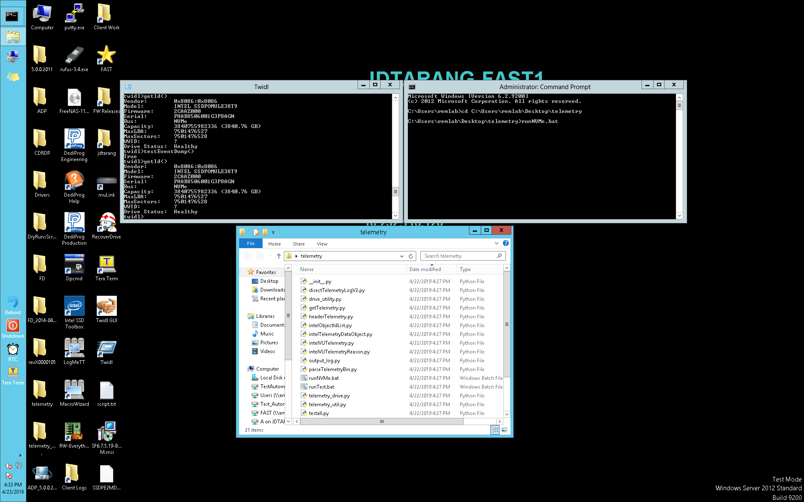
Example Developer Stimulation of Event
Open TWIDL
unlock();testEventDump()
Open Command Line
Navigate to telemetry developer folder
Execute commands manually
runNVMe.bat

Slide 112
Simulation Mode

Slide 113
Advanced Developer Debugging
Telemetry with no Event or Assert
GHS simulation Environment (I.E. Telemetry.rc)
Tsim()
<serial>.rc
Development GHS simulation Environment (I.E. AssertNVMe.rc)
Extract eUID list to load
Verify headers
Enable simulator mode via
AssertDump() and select event or assert dump *.bin
I.E. Simulator Initialization I.E. connect simarm_compat -rom_use_entry -allocmem -cpu=cortexr4 –nofpu
I.E. DRAM Allocate - target alloc 0x20600000 0x00600000 // allocate DRAM mem region
Advanced Memload eUID into simulation memory
I.E. memload raw dram.bin -offset 0 &defragInfo
Automating can occur by similar function by SaveOrRestoreStdDump()
I.E. TelemetryV2_RegisterTransportObject(objectId, majorVersion, minorVersion, objectSize, dataptr)
View data structure
view defragInfo

Slide 114
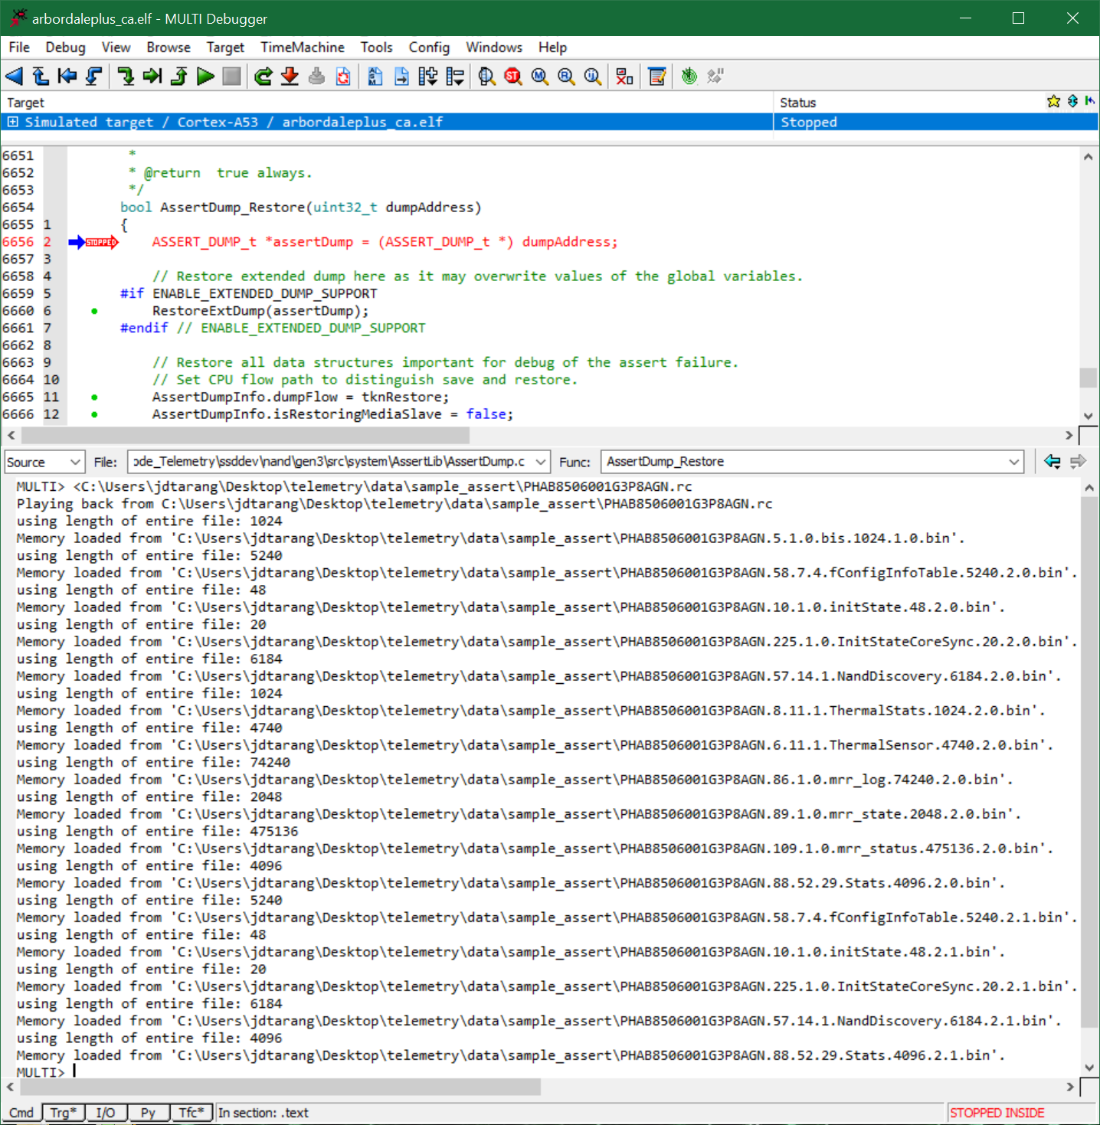
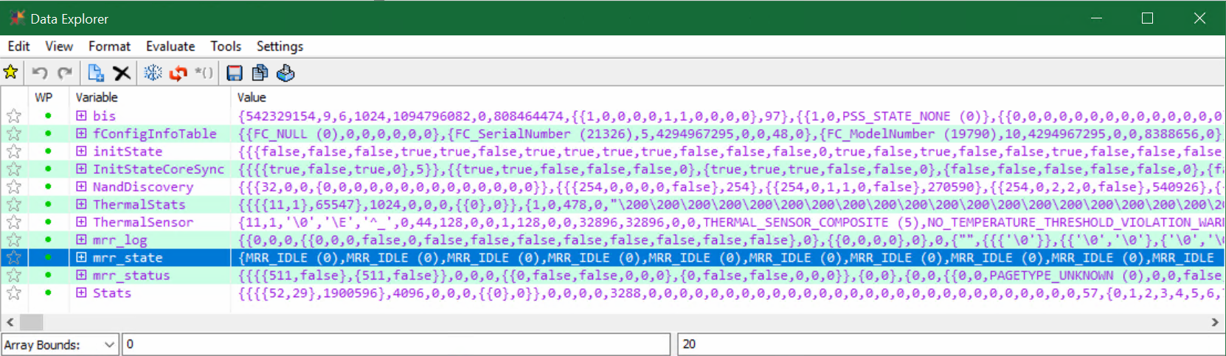
Telemetry Data Object Simulation Loading
Simulation Semantics
Tsim()
Loads the Chip Family CPU simulator
Allocates memory for simulation
Load data objects
Requires Tsim()
The script loads select data objects
The script automatically opens loaded objects

Slide 115
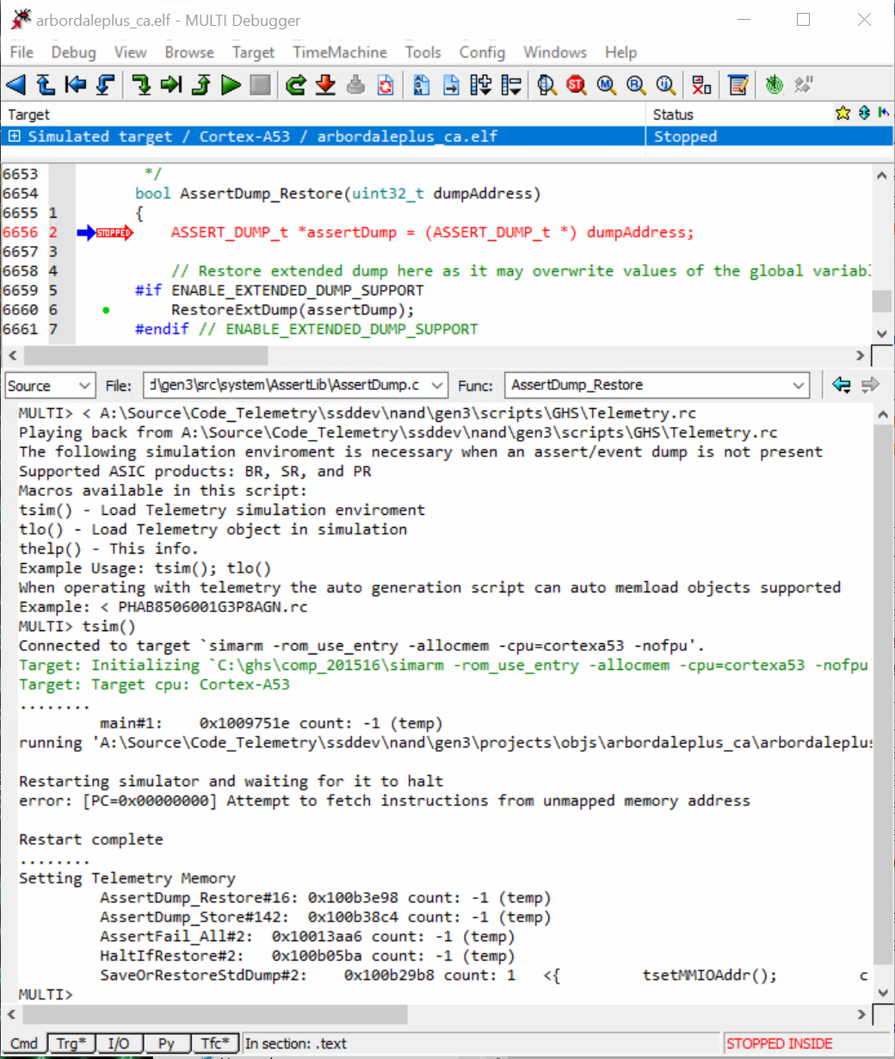
Simulator Mode Setup for Telemetry Objects
Checkout code node, compile project, and open specific project elf
Load objects without assert dump or event dump
Load in Telemetry.rc
Call Tsim()
Setups the telemetry simulation environment
Load the autogenerated *.rc script
Location
telemetry\sample
File: “PHAB8506001A3P8AGN.rc”
Format is related to the device serial number “<serial number>.rc”
Script to load supported data structures
“< \tools\telemetry\sample\PHAB8506001A3P8AGN.rc”
Optional
Tload() – The graphical interface for loading any telemetry object binary.

Slide 116
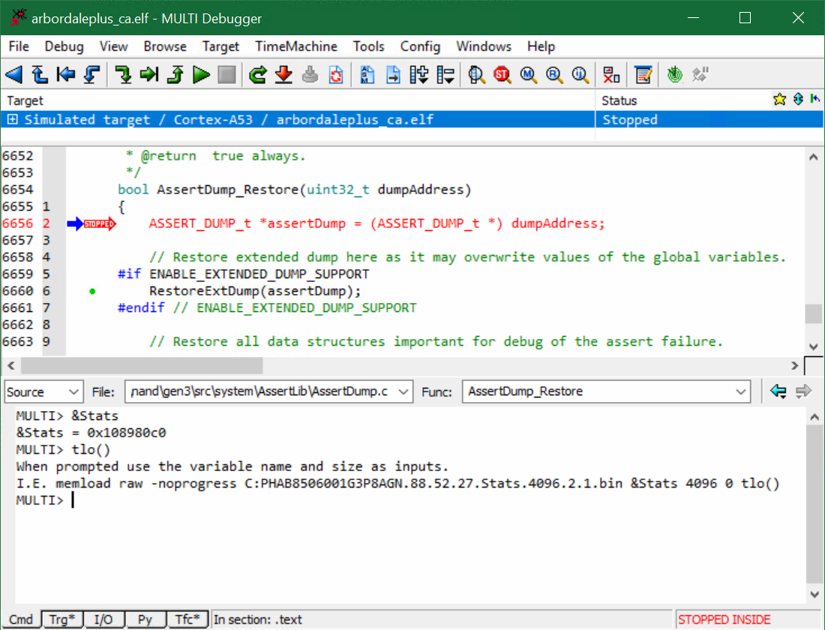
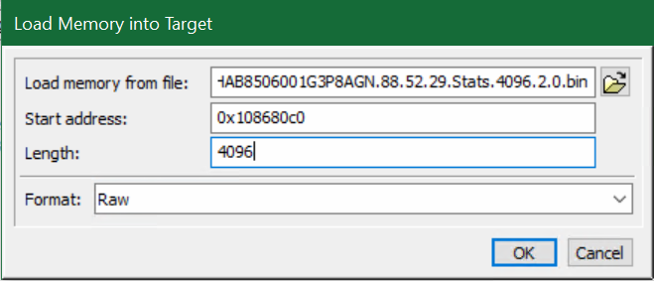
Simulator Mode Data Load
memdump raw GP.bin GeneralPurposeBuffer numBytes
To load an individual object
Command
memload -GUI | [srec|raw|legacy] [-w WRITESIZE] [-noprogress] <filename> [-offset <file_offset>] [<start> [<length>] | <section>]
Example one liner
memload raw PHAB8506001A3P8AGN_CORE0_DefragInfo.bin &DefragInfo sizeof(DefragInfo)
Easier Graphical method
memload –GUI

Slide 117
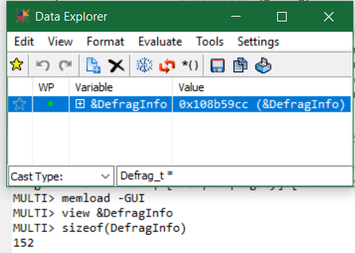
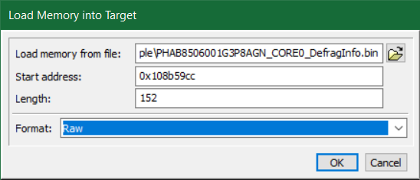
Simulator Mode Determine inputs for GUI
When data is unclear, we can use GHS commands to review the inputs
Find Address
View &DefragInfo
Find Size
sizeof(DefragInfo)
To load the data, we navigate to the telemetry segmented packet binary
Enter address, length, and raw format

Slide 118
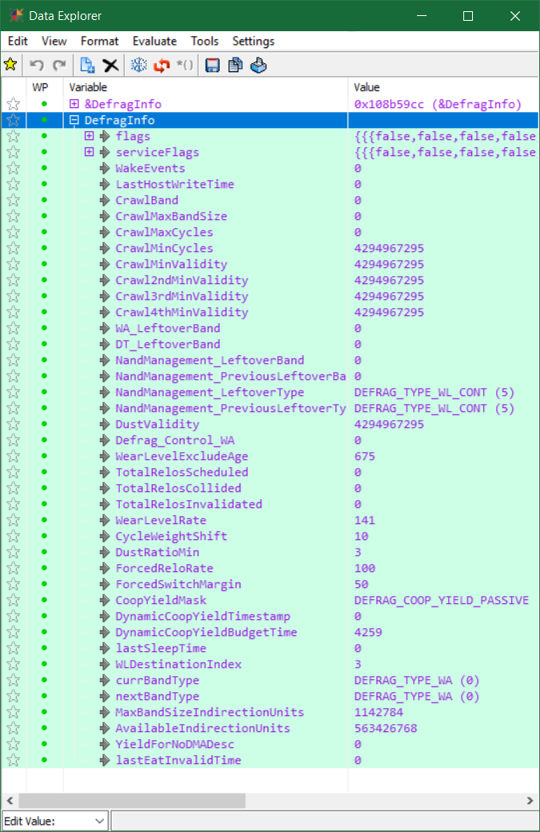
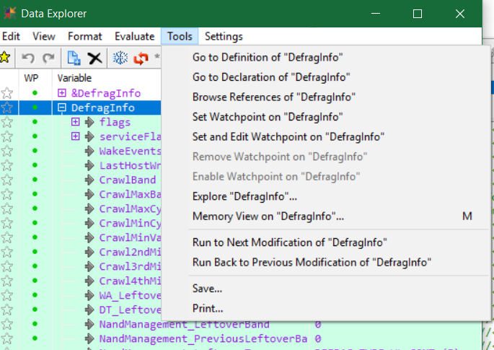
Example Memory Load of Content
After loading the data we can now analyze the data from a telemetry packet within the developer environment.
Data from these can be saved individually

Slide 119
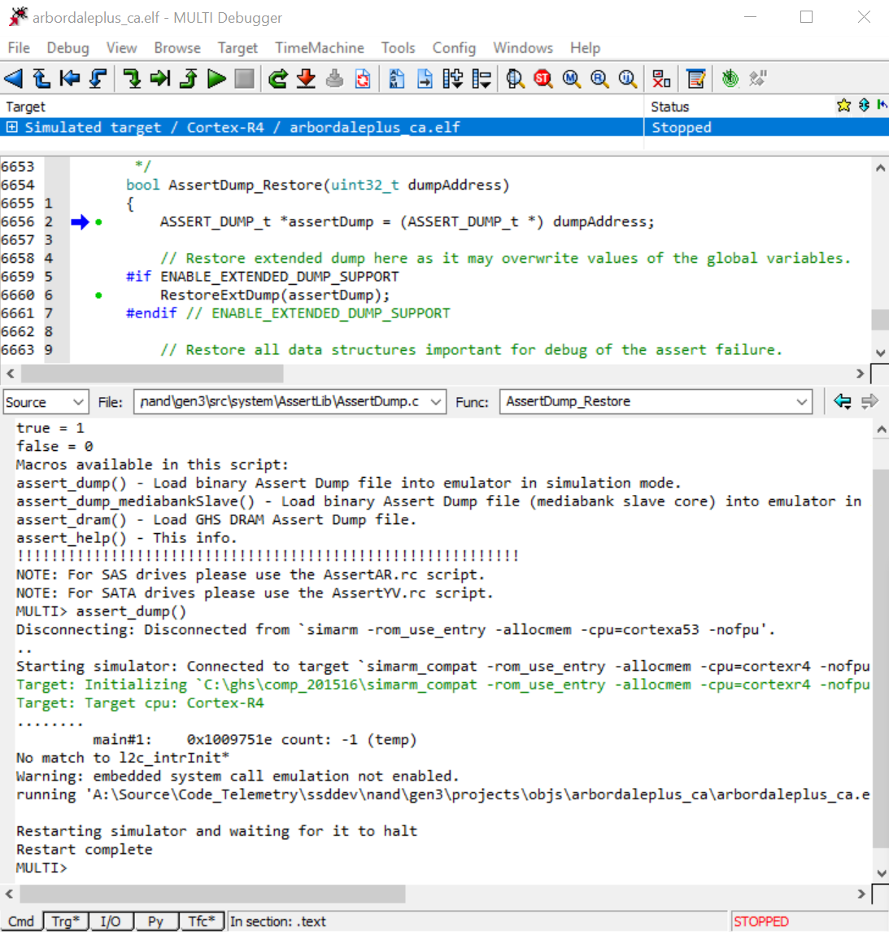
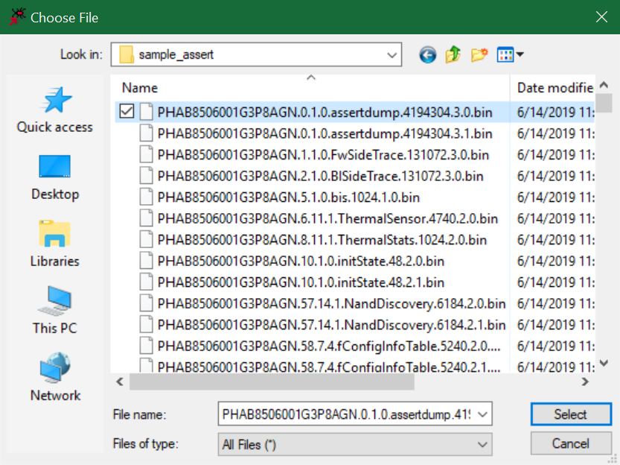
Simulator Mode Setup for Telemetry Assert and Event
Checkout code node, compile project, and open specific project elf
Load objects with assert dump or event dump
Load Assert Dump, if it exist (Data Area 3)
Load in AssertNVMe.rc
Call assert_dump().
Unique IDs for assert and event dumps
uid_assertdump_e = 1
uid_dpEventDump_e = 4
Size (approximately)
1.7 MB to 32MB
Select file
PHAB8506001A3P8AGN_assertdump.bin
Viewing through GHS command line
view ($dump) // Assert/Event dump
callsview // Display the stack
view $locals // local function variables

Slide 120
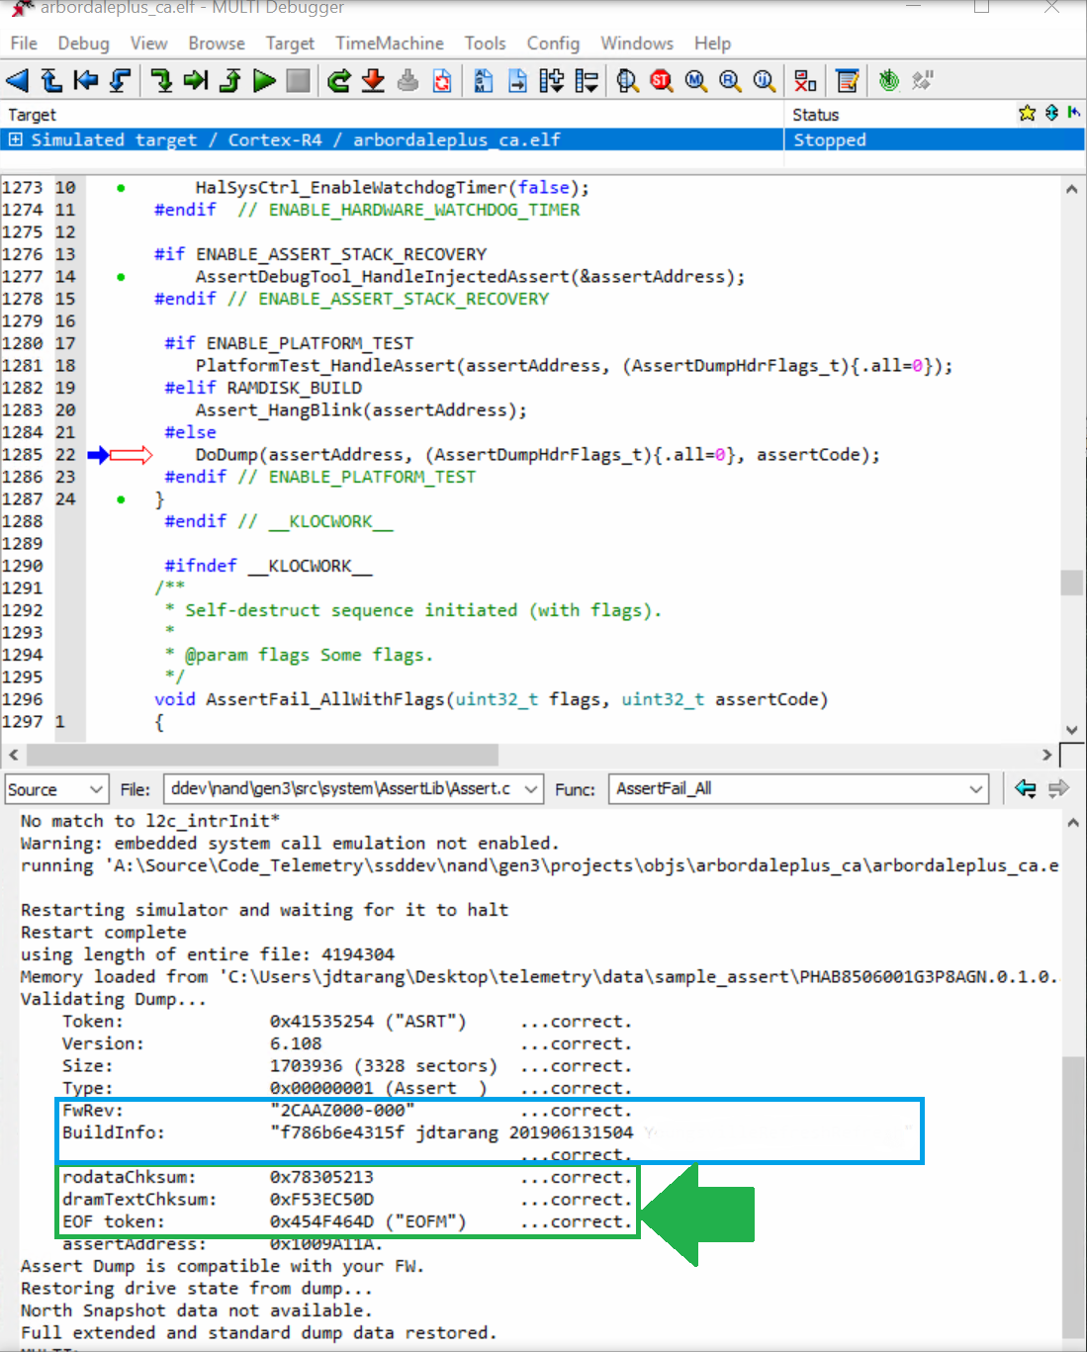
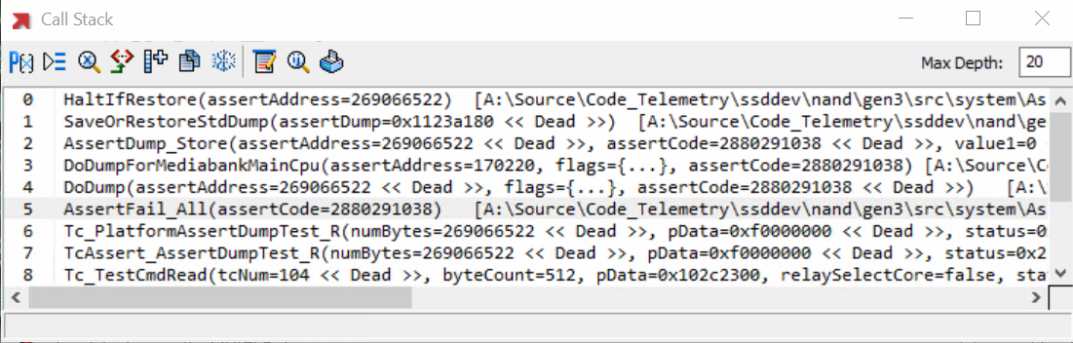
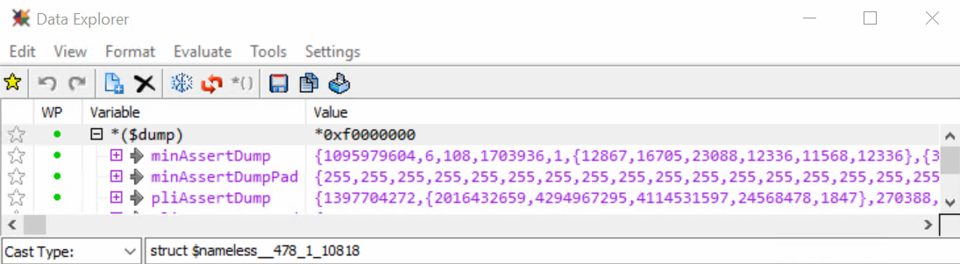
Content Verification with Assert/Event Dump
It is important to know you assert dump is loaded correctly!
The following shows a dump that was build from bench then loaded with the dump form the device.
In the field we use performance code so the “FwRev” and “BuildInfo” will show different values
The import items are to check for the “chksums” are correct.

Slide 121
Useful Commands GHS Commands
bpview, breakpoints -- Opens the Breakpoints window (located in the Breakpoint Command Reference).
browse -- Opens a browser for the specified object type.
browseref, xref -- Displays the specified object's cross references in a Browse window or MULTI's command pane.
callsview -- Opens the Call Stack window, which lists all functions on the call stack (located in the Call Stack Command Reference).
connectionview -- Opens the Connection Organizer window, which allows you to create, edit, and manage Connection Methods (located in the Target Connection Command Reference).
diff -- Opens the Diff Viewer on two versions of the same file or on two different files.
edit -- Opens an Editor on the file and line specified.
editview -- Opens a MULTI Editor for the object specified.
heapview -- Opens the Memory Allocations window.
localsview -- Displays the current function's local variables in a Data Explorer.
memview -- Opens a new Memory View window for displaying and modifying memory contents.
noteview -- Navigates to the location of the specified Debugger Note or opens a Note Browser displaying all Debugger Notes for the program being debugged (located in the Debugger Note Command Reference).
viewlist -- Displays a list of structures in the Data Explorer.
window -- Creates, deletes, lists, or changes the contents of a monitor window.
osaview -- Opens the OSA Object Viewer (located in the Scripting Command Reference).
regview -- Opens a Register View window displaying all registers, or opens a Register Information window displaying the specified register (located in the Configuration Command Reference).
showdef -- Searches for a C preprocessor definition for each specified name.
showhistory -- Displays the specified source file's revision history in the History Browser.
taskwindow -- Opens the Task Manager in a run-mode debugging environment or displays it in the foreground if it is already open (located in the Scripting Command Reference).
top -- Opens a Process Viewer window, which displays a snapshot of the processes on your native target.
update -- Re-evaluates all currently open Data Explorer and monitor windows, halting the process if necessary to get the updated information.
view -- Displays the given items in a Data Explorer, a Browse window, or an OSA Object Viewer.
viewdel -- Closes all Data Explorer, Browse, Register View, Memory View, Call Stack, and Breakpoints windows.

Slide 122
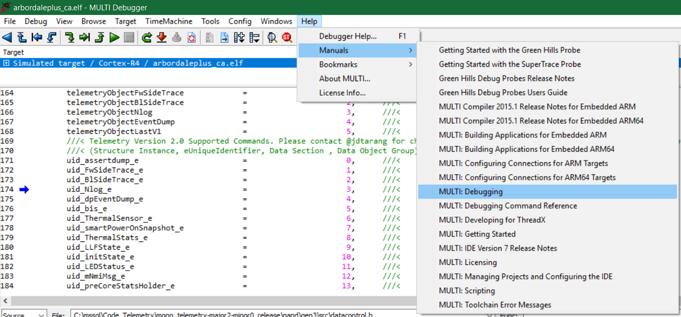
Simulator Mode Help

Slide 123
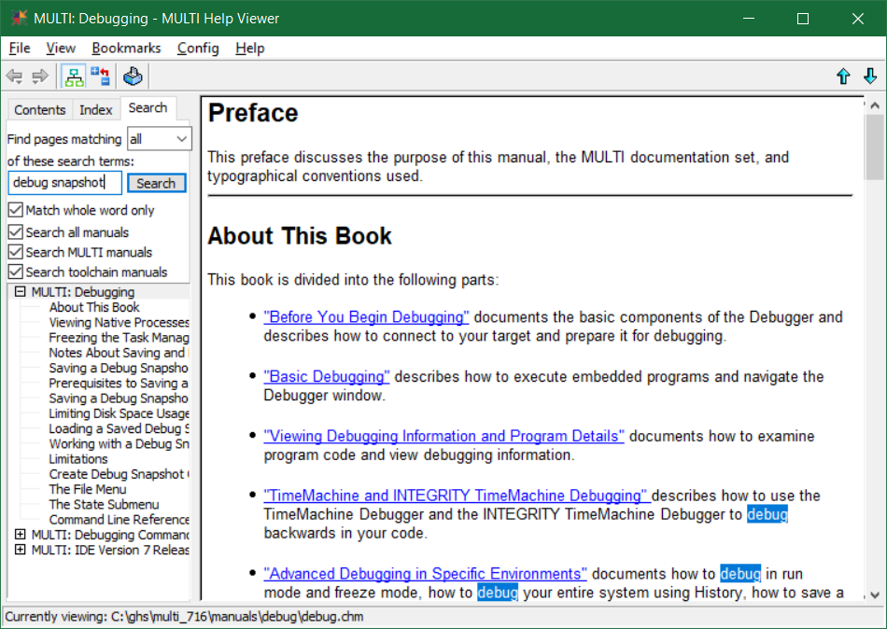
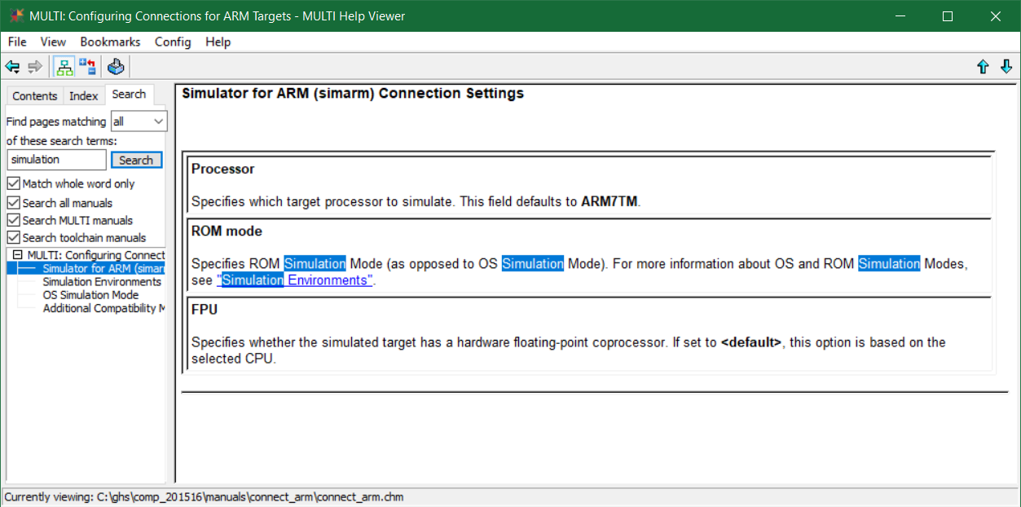
Simulator Mode Help Search

Slide 124
Sharing Developer Content

Slide 125


Useful Context Saving of Content to Share
The save debug snapshot is useful to save the session
Loading the debug snapshot allows for developers to diligently share the session and get up to speed quickly
If any of these fail we can save via write to file

Slide 126


Details on Saving Snapshots

Slide 127

Debug Snapshot Saving Commands

Slide 128
Predictable Outcomes
Creating a systematic manner to evaluate faults (Starting Point)
Enhancing the time to triage from generated case analysis
Highlighting architectural limitations
Creating path to disseminate knowledge to NSG
Providing feedback loop of challenges seen in firmware engagements
Developing a standard fault response for customers enhancing confidence in technical rigor.
Highlight critical module transactions in development to prevent secondary failures.
Application Engineers will have an expected path to engage in technical communications reducing customer response time.

Slide 129
Appendix
Notes:
Joe

Slide 130
Opportunity Ownership on Action(s) Required
Data Control
Meta Git repository
Cross branch database resolver
PacManIC.py parser
Host test machine
Detect FW build
Auto sync Git parser
Telemetry Object Dictionary
Indirection system
Name
Location Accessor
File organizer
Database API(s)
Build System
All telemetry Tools in testball
Script improvements
Bad Context
Rework so Bad Context issues a controller-initiated telemetry event.
Object(s) Supported
More data objects
Security Auditing
Plan ready and needs execution
Telemetry Data [Patent(s) Pending]
Top Secret Sauce…

Slide 131
Data Vision

Slide 132
Vision Data Control, Gaps, and Path
Data Additions required to go through working group
Native Data Type Instance Reservation
Repository Specific Sets
Short Term
Data Control table since we cannot major roll all data structures
Long-term
Standardized header for significant objects
Version, Security, Persistence Type
Change detection
Pre-processor size detection
Runtime version detection
Tools
Fault results from TWIDL requiring a single flat representation
Current BKM for data structures would require O(N!*M) to code
Firmware uses
Inherence of types, unions, and dynamic casting
Short Term
Firmware Tools Solution
Long term
Firmware Structures to Python C-Type

Slide 133
Interesting Usage Case for Data Lake

Slide 134
Data Clustering
Storage analytics concepts where the analytics nodes are open-source tools, such as:
InflaxDB and Grafana (for data visualization)
Developed by the S/W team in Gdansk, Poland
Intel Drive Failure Prediction Tool
WIP
Its current analysis is based on SMART attributes, but the plan is to use the Telemetry structures as well (only HIT)

Slide 135
Ideas -> IDFs -> Patent

Slide 136

Telemetry was an Idea… and I have one too!
Reach out to experts with Patents
Jim, Joe, etc.
Just go for it!
Get a Mentoring Buddy!
Develop a Plan
Intern Plan
Telemachus
Career Connections

Slide 137
Telemetry Redefining Interfaces and Topologies

Slide 138


Disrupt SSD Standards with Intel Uniqueness
Novel
Admin and Support Interface
Observations
Enterprise SSD Mechanical Connector
Open SFF interface pins: E6, E16, and E17.
Hypothesis
Create Rx/Tx, Clk custom interface for Intel to OEM customized support within the Infrastructure
Projected Outcome
Loyalty and Confidence

Slide 139
Administration, Access, Telemetry (Storage Focus)
Administration and OEM Interface
Remote access to system
Requires
Robust secondary interface operational independent of device enumeration
Hardware separated into core and secondary interfaces
Benefits
Device fault does not require physical interaction
Interface does not require strict training speeds
Allows on fault device can operate at low speeds with extraction

Slide 140

Method and Apparatus for Customer Solid State Drive (SSD) System Telemetry Adaptation, Prediction, and/or Limber Error Recovery (STAPLER)
Inventors Joseph Tarango, Jim Baca

Slide 141
Telemetry Data Formats Decoder

Slide 142
Decoder Details
Example data requirements configurations
Product Key – Unique identifier to note the product family, model, configuration, and serial number, etc. to be used in decrypt the private Intel Information
Security Key – Data encryption information key based on transactions
Version Control – As the firmware matures over time internal tools will need to understand the version of firmware and provide mechanisms to communicate access and interpretation.
Access Type: Identification, administration, meta data acquisition accessor, mutator, enhanced failure analysis mode, and custom extensible commands
Streaming capabilities
Payloads of contiguous data for failure triage, snapshots, customer optimizations, etc. through virtual memory mapping of all SSD data.
Performance tracing of hot paths used to optimize the configurations
Defragmentation logs to enhance the policies through updates in configurations
Customer trace logs for commands to provide detailed path analysis and functionality for in the field evaluations
Host Events for AI Training, Learning, and Adaptation
Used for predictive failure
Continuous improvement feedback
Environment usage data
Etc.
Generic read/write access abilities.
Automated recovery instruction packet to isolate and provide recovery for the SSD.

Slide 143
Analysis Use Cases
Intel internal continuous validation
Remote Developer
Advanced regression analysis
Reliability demonstration testing (RDT)
Code Coverage
Correlation Between
Media
ASIC
Firmware Paths
Data sets, structures, modules
System Features
Customer/Internal Faults
Fastest Escalation Chains with JIRA
Successful Recovery Modes
Prototype new features to enhance the customer experience and enable in the field.

